Slide 1
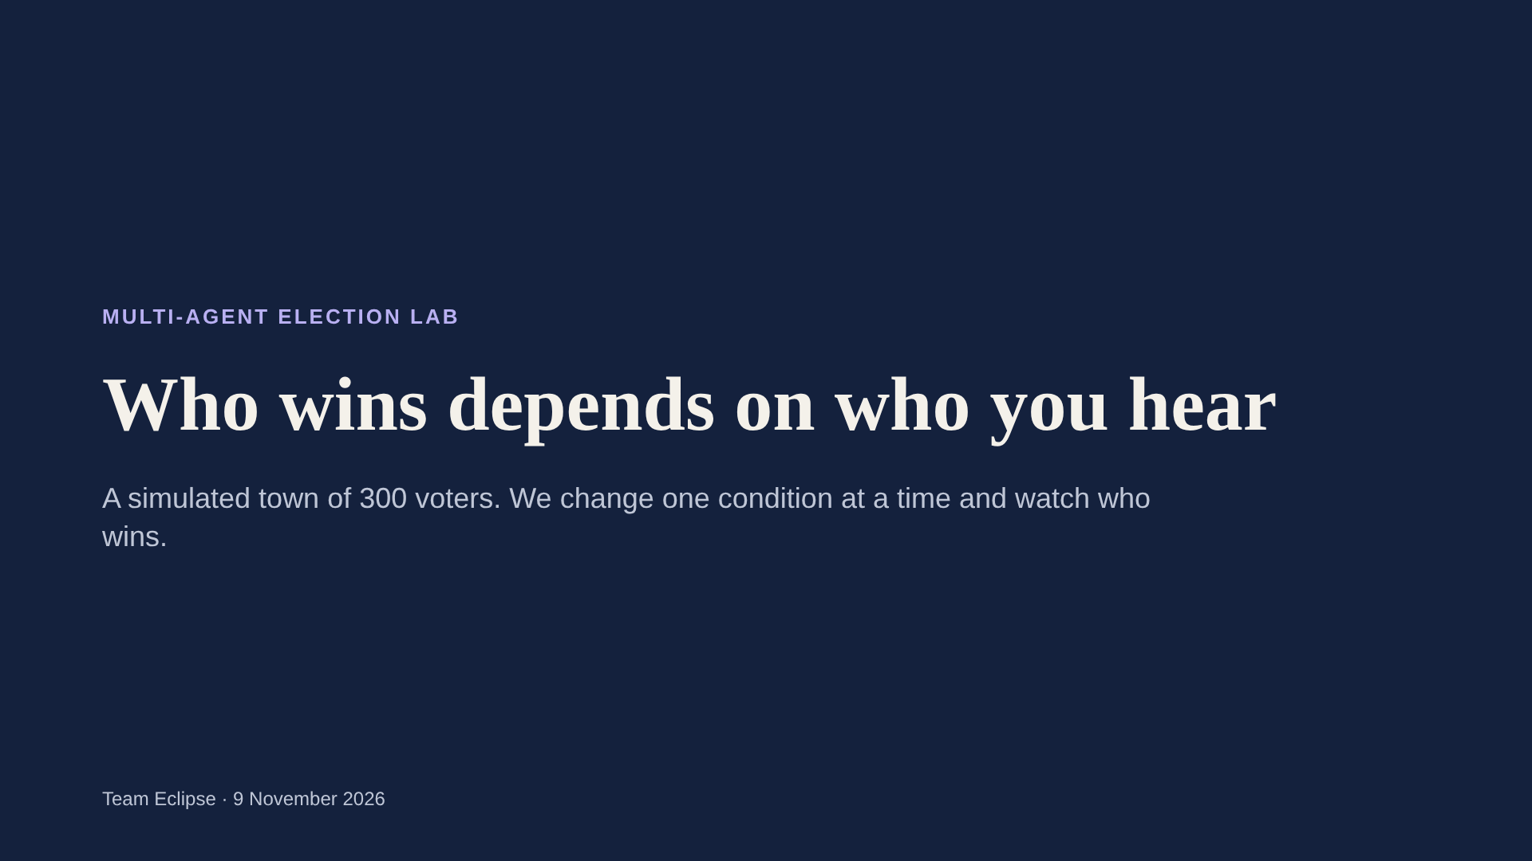
Notes:
We work on elections, and on a few things that happen in them that we found interesting: people voting tactically, people following the crowd, people only seeing what their friends do, and small groups trying to sway everyone else. To study them we use our team's multi-agent election engine. It simulates a town of 300 voters who vote again and again, and every voter reacts to the votes they saw in the previous round. The method for the whole talk is simple: we keep the town the same and change one condition at a time, and then we look at whether the winner changes. Every animation you will see is replayed from real runs of that engine, not drawn by hand.

Slide 2
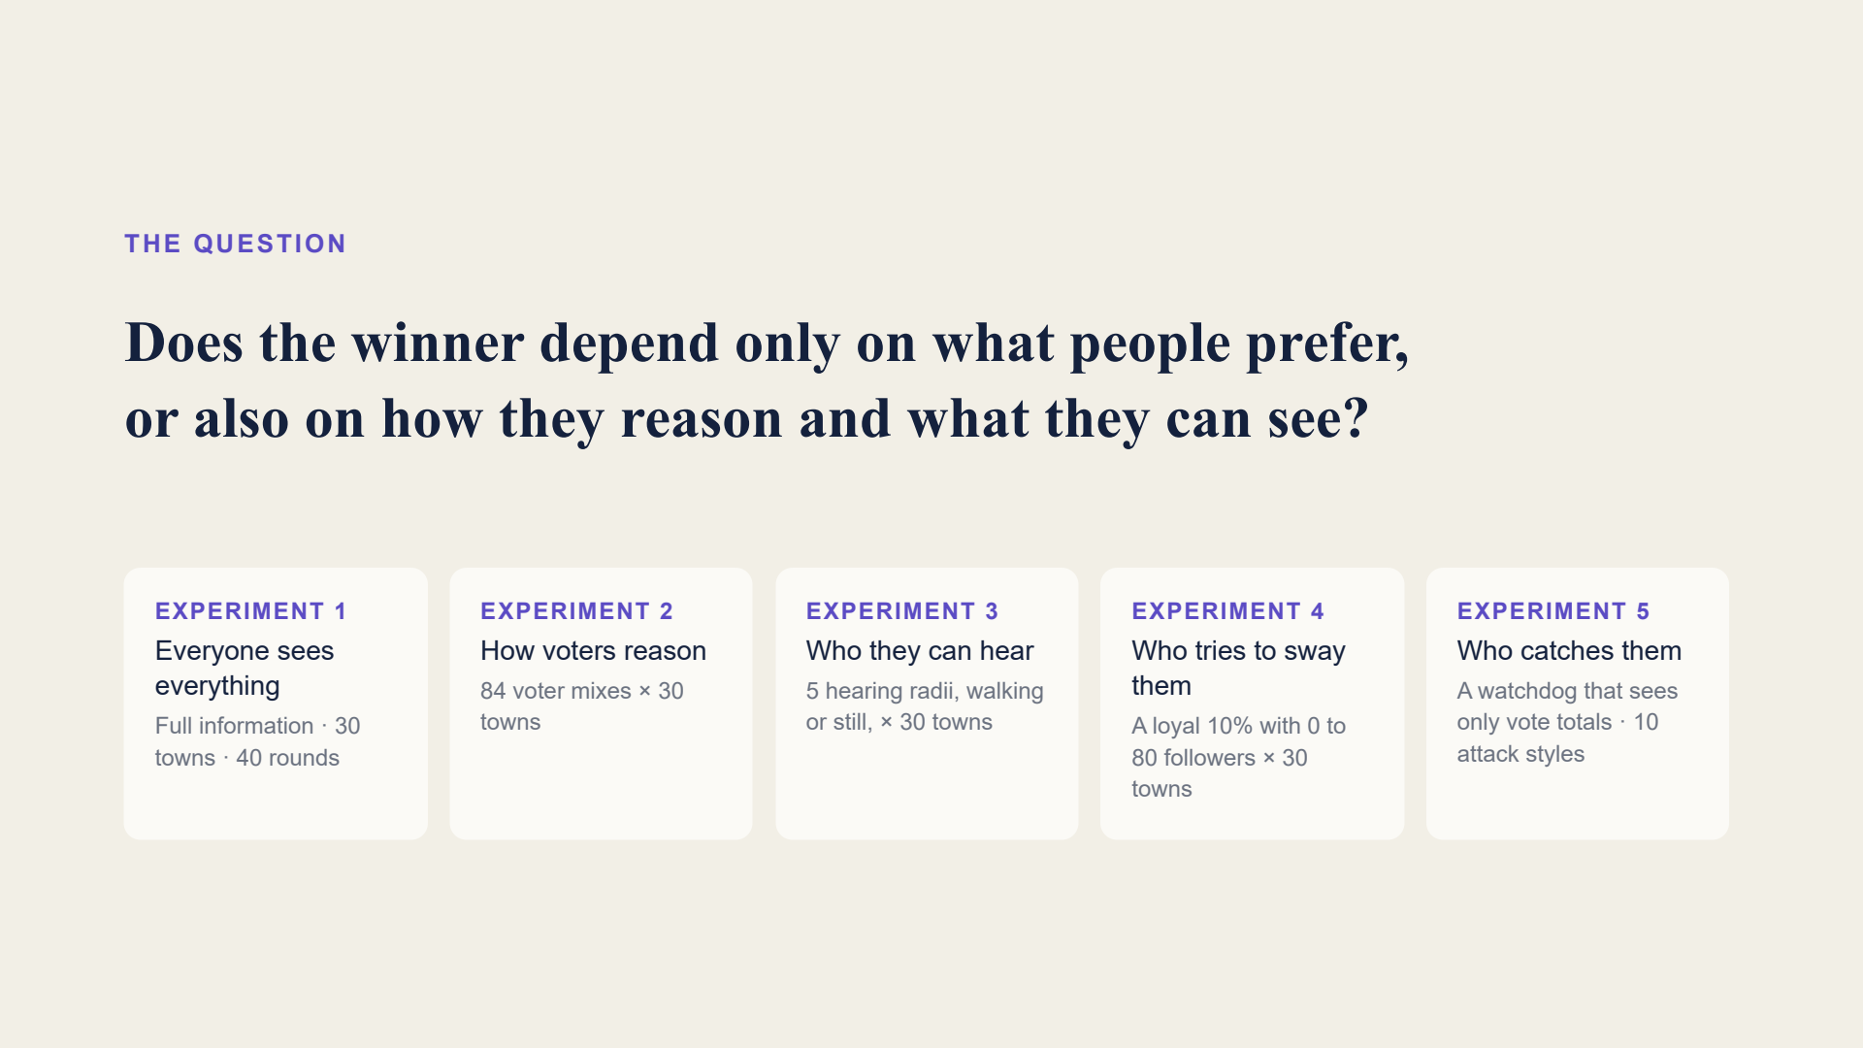
Notes:
Here is the one question behind the whole talk. In school we learn that an election adds up what people prefer. But real voters also reason about the election: is my candidate even viable, what are my friends voting for. And they only see part of what everyone else is doing. So we ask: does the winner depend only on preferences, or also on how people reason and what they can see? We answer it in four steps, and each step adds one thing. Experiment 1: everyone sees everything, the cleanest case. Experiment 2: we change how voters reason, by changing the mix of voter types. Experiment 3: we limit what each person can hear, and let people move around so their contacts change. Experiment 4: we add a small organised group that tries to sway everyone else. Opinions stay exactly the same in all four. If the winner changes, it is because of the condition we changed. Experiment 5 adds a watchdog: someone who sees only the vote totals and tries to catch a deliberate slow takeover.

Slide 3
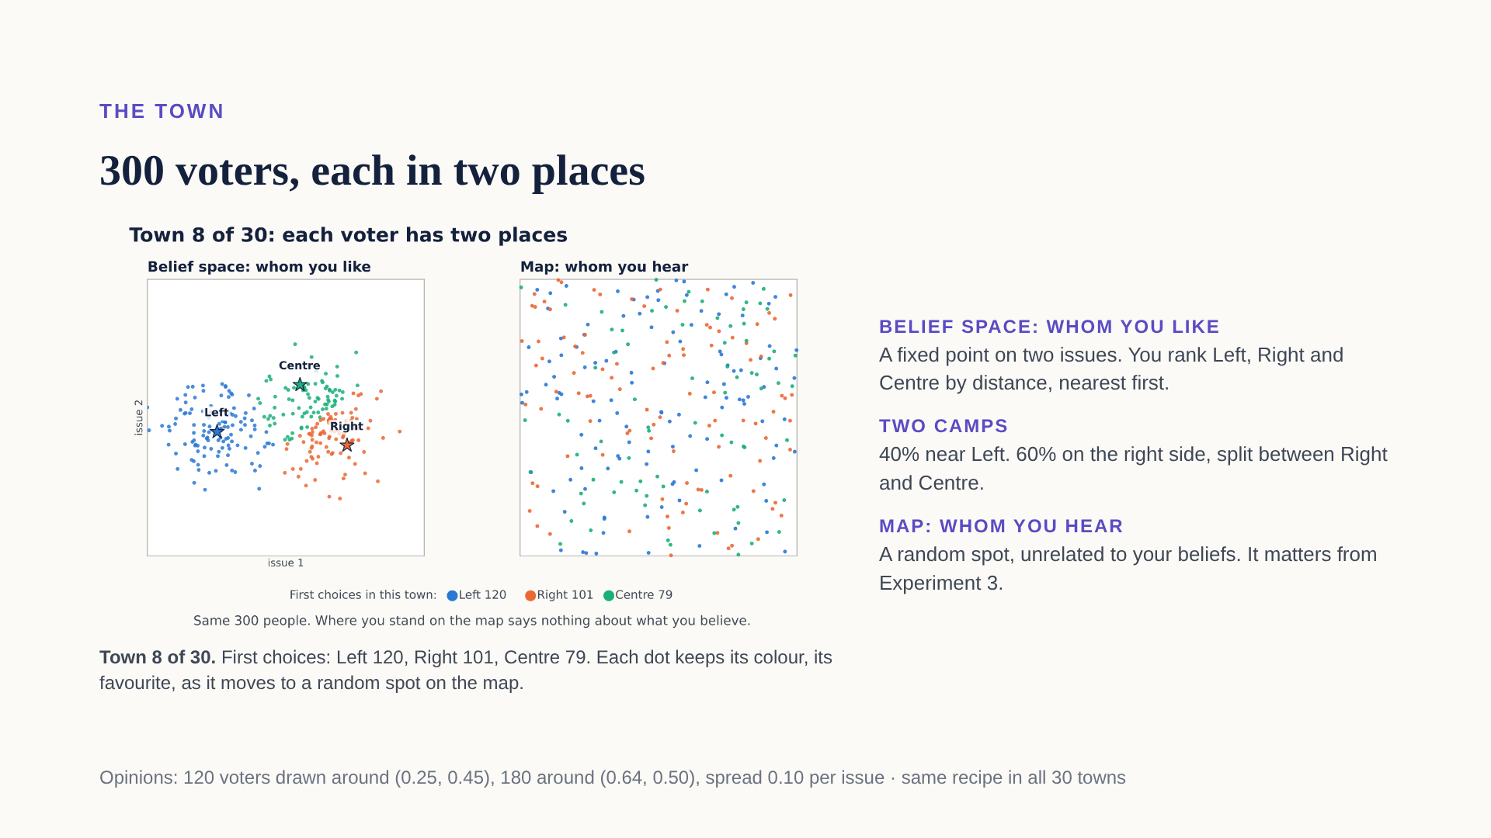
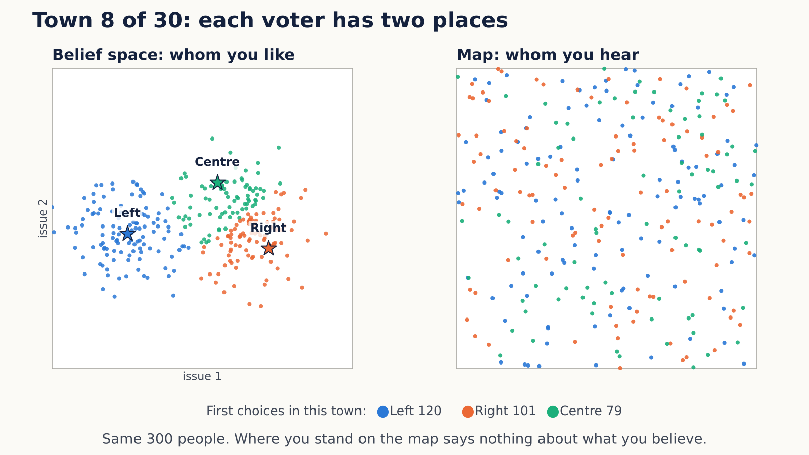
Notes:
This is our town. Every voter is a dot, and every voter lives in two places at once. The left square is the belief space. Think of it as two issues, say the economy on one axis and social questions on the other. Each voter has a fixed point there, and they like candidates that are close to them. The three stars are the candidates: Left, Right and Centre. A voter sitting near the Left star ranks Left first, and so on. The colour of a dot is that voter's favourite. Opinions come in two camps. About 40 percent of people sit around Left. The other 60 percent sit on the right side, and that camp is split: some are closer to Right, some closer to Centre. Now watch the dots fly. Every voter also stands somewhere on a separate map, and that spot is random. It has nothing to do with what they believe, so the colours get completely mixed: your neighbour on the map can think the opposite of you. The clip is town 8 of our 30. Its first choices are Left 120, Right 101 and Centre 79, which is close to the typical town. The map decides whom you hear. We will not need it until Experiment 3, but this is where it comes from. Opinions never change during an election; that stays true for the whole talk.

Slide 4
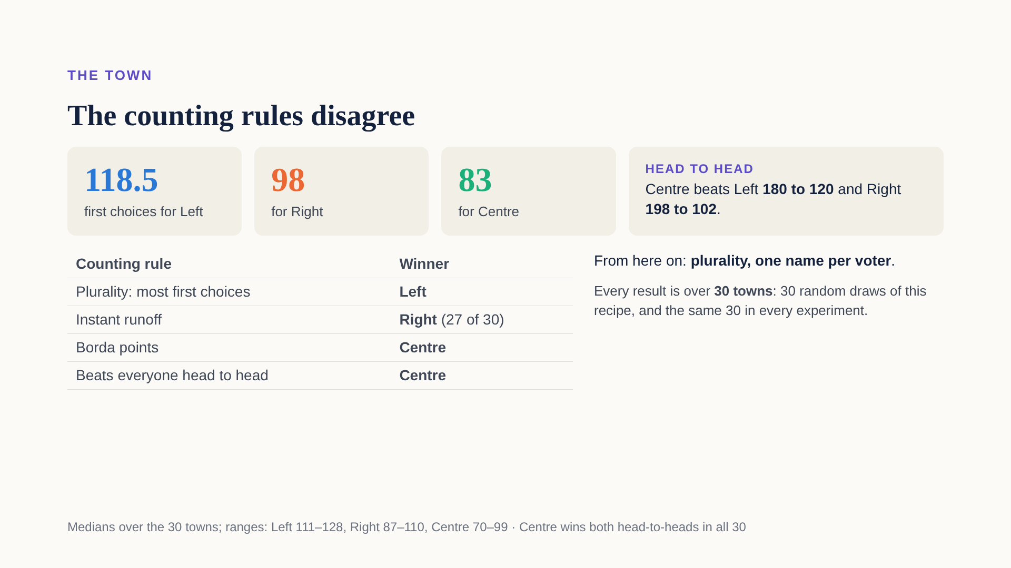
Notes:
Before any strategy, here is why this town is interesting. Count everyone's favourite and Left is biggest, with about 118 of 300 first choices, then Right with 98 and Centre with 83; these are medians over the 30 towns. But Centre is almost everybody's second choice. Head to head, Centre beats Left 180 to 120 and beats Right 198 to 102. So the textbook counting rules disagree. Plurality, where the most first choices wins, picks Left. Instant runoff usually drops Centre first, and most of Centre's voters prefer Right to Left, so Right wins in 27 of 30 towns. Borda points and the head-to-head rule both pick Centre. The point: even with fixed opinions, who wins already depends on the rules of the game. From now on we keep one rule fixed: plurality, one name per voter, as in the UK, the US or India. What we vary is how people vote, and what they can see. One more thing about the word town. A town is one random draw of this recipe: where everyone's opinion falls, where they stand on the map, which type each person is. We use 30 of them so a result is not a fluke of one lucky draw, and the same 30 are reused in every experiment. When I say Left wins 30 of 30 towns, it means it won in all 30 draws.

Slide 5
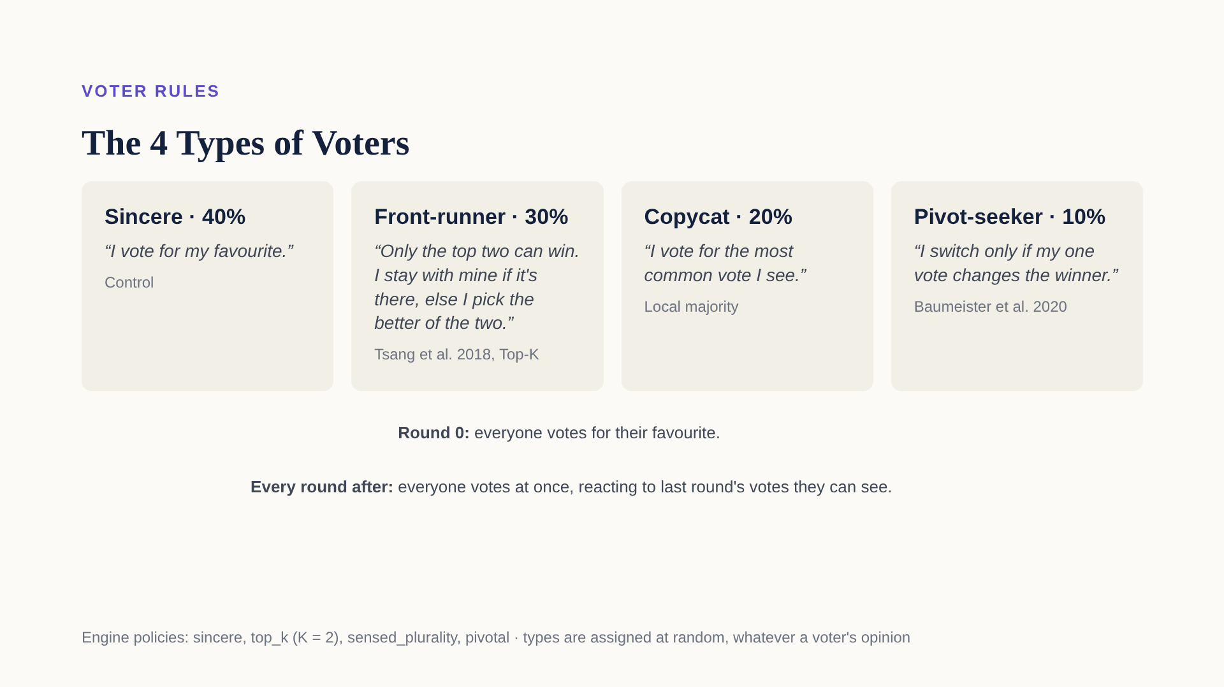
Notes:
Now the people. Every voter has one of four types, and the default town is 40, 30, 20 and 10 percent. Sincere voters, 120 people, always vote for their favourite, whatever happens. They are our anchor. Front-runners, 90 people, believe only the top two can win. Each round they look at the votes they can see and find the two leaders. If they already back one of the two, they stay. If not, they move to whichever of the two they like more. Example: a Centre fan who sees Left and Right leading moves to Right, because they prefer Right to Left. That is the classic don't-waste-your-vote voter. Copycats, 60 people, vote for the most common vote they see, whatever their own preference. That is the bandwagon, or herd, voter. Pivot-seekers, 30 people, only switch if their single vote would change who wins. In a town of 300 that almost never happens, so in practice they behave like sincere voters, and you will see that in the data. The timing: in round 0 everyone votes for their favourite. Then, every round, everyone looks at last round's votes they can see and votes again, all at the same time. We run 40 rounds, and 150 in some long runs.

Slide 6
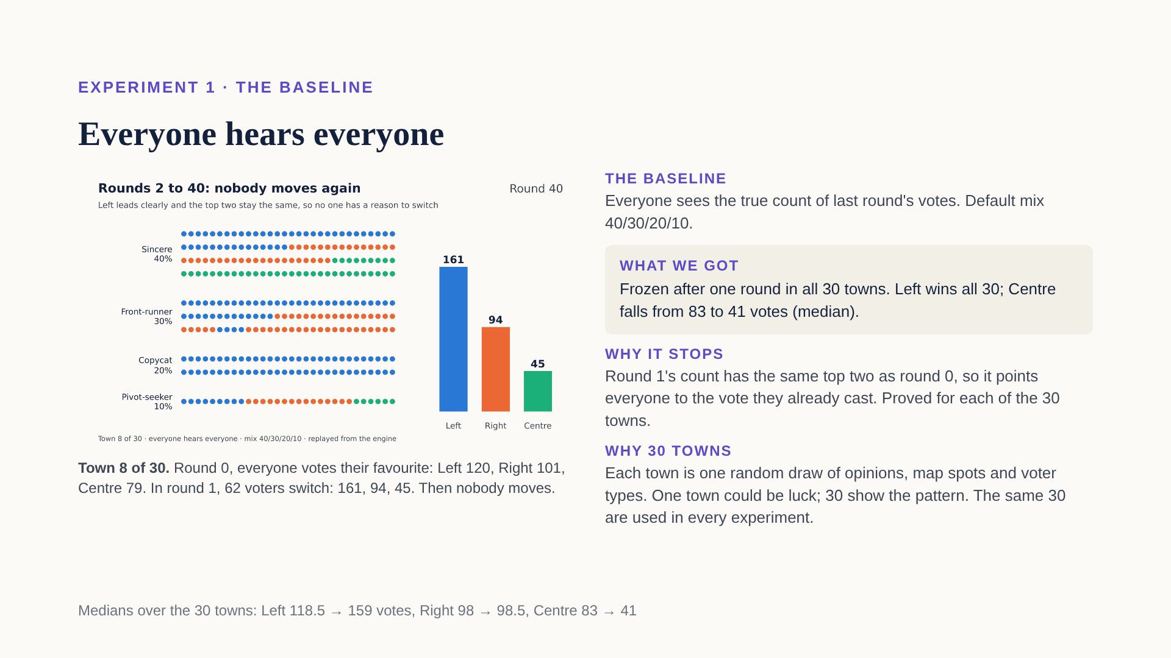
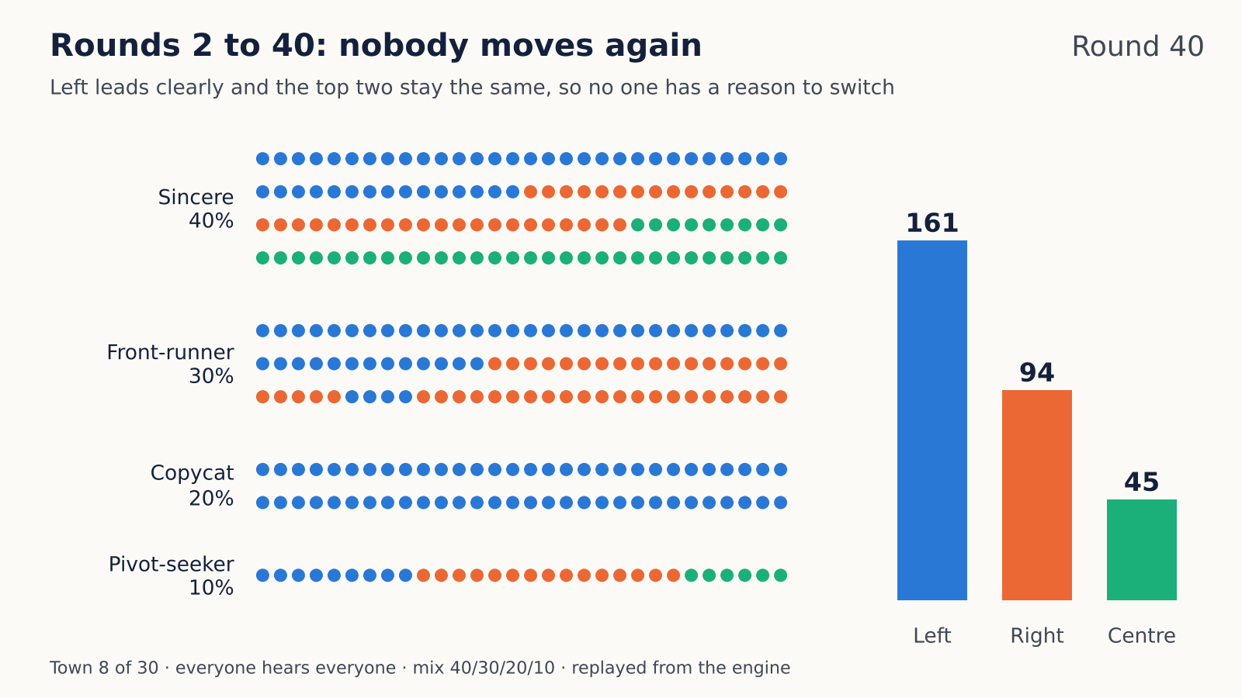
Notes:
Experiment 1 is our baseline, the true thing: everyone sees the true count of last round's votes, as if one accurate poll were shared with the whole town. Nothing else is added, and the mix of types is the default 40, 30, 20, 10. Watch the clip. It is town 8. Each dot is a voter, grouped by type and coloured by their vote. In round 0 everyone votes for their favourite: Left 120, Right 101, Centre 79. In round 1 everyone reacts to that count at the same time. Copycats see Left on top and jump to Left, even Right and Centre fans. Front-runners see Left and Right as the top two: those already on Left or Right stay, and those on Centre move, mostly to Right, because most Centre fans prefer Right to Left. Sincere voters and pivot-seekers stay put. 62 voters switch, and the count becomes Left 161, Right 94, Centre 45. After that, nobody ever moves again. Why it stops: the round-1 count shows the same top two as round 0, here Left and Right, with gaps too big for any single vote to change. Every rule only looks at who the top two are, so the count points everyone to the vote they already cast: copycats are already on Left, front-runners are already on one of the two. That is a proof, not just a simulation, and we checked its condition in every one of the 30 towns: round 1 always keeps round 0's top two, Left and Right in 27 towns, Left and Centre in the other 3. It is not automatic, by the way: when counts are nearly tied, votes can loop forever, which is why we check it town by town. Why 30 towns? A town is one random draw: where everyone's opinion falls, where they stand on the map, and which type each person is. One town could be a lucky draw, so we use 30, and we reuse the same 30 in every experiment. So when the winner changes later, it is because of the condition we changed, not because the towns changed. Result across all 30: frozen after one round in every town, Left wins all 30, and Centre falls from a median of 83 votes to 41, even though Centre beats both rivals head to head. This is the reference point for everything that follows.

Slide 7
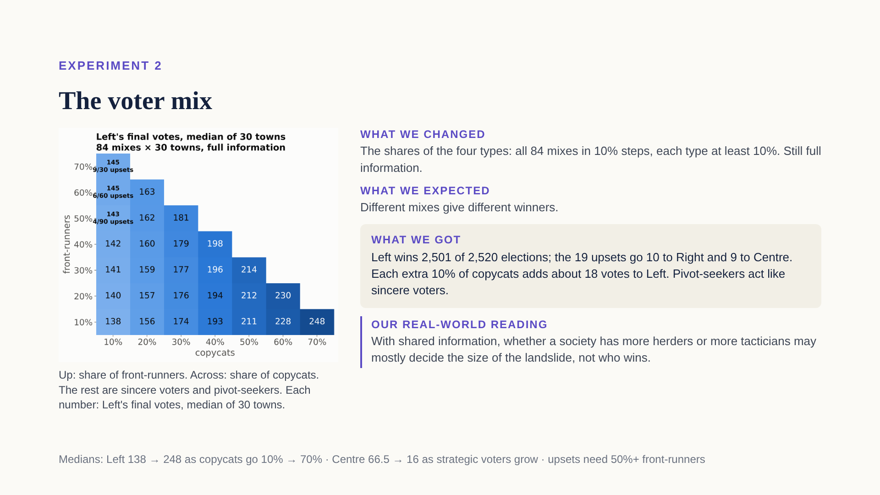
Notes:
A fair challenge to Experiment 1 is: maybe Left only won because of the mix we picked, 40, 30, 20, 10. So we tried every mix in 10 percent steps where each type is at least 10 percent. That is 84 mixes, each on all 30 towns, still with full information. We expected different mixes to give different winners. They mostly do not. Left wins 2,501 of 2,520 elections. What the mix changes is the margin. In this grid, going right means more copycats and going up means more front-runners, and each cell is Left's final vote count. Copycats are a bandwagon: they all jump onto whoever leads the first count, and Left always leads the first count. So each extra 10 percent of copycats is about 18 more votes for Left: from 138 on the left edge to 248 in the far corner. Front-runners work differently: they hardly change Left's own votes, but they narrow Left's lead over the runner-up, because Centre fans who are front-runners mostly move to Right. Only in the top-left corner, with lots of front-runners and almost no copycats, does Left sometimes lose: 19 of the 2,520 elections. Pivot-seekers behave like sincere voters, because one vote in 300 is almost never decisive; that is why we can collapse them into one grid. Our real-world reading: when everyone sees the same information, whether a society has more herders or more tacticians may mostly decide how big the landslide is, not who wins. So if personalities don't change the winner, maybe information does. That is the next experiment.

Slide 8
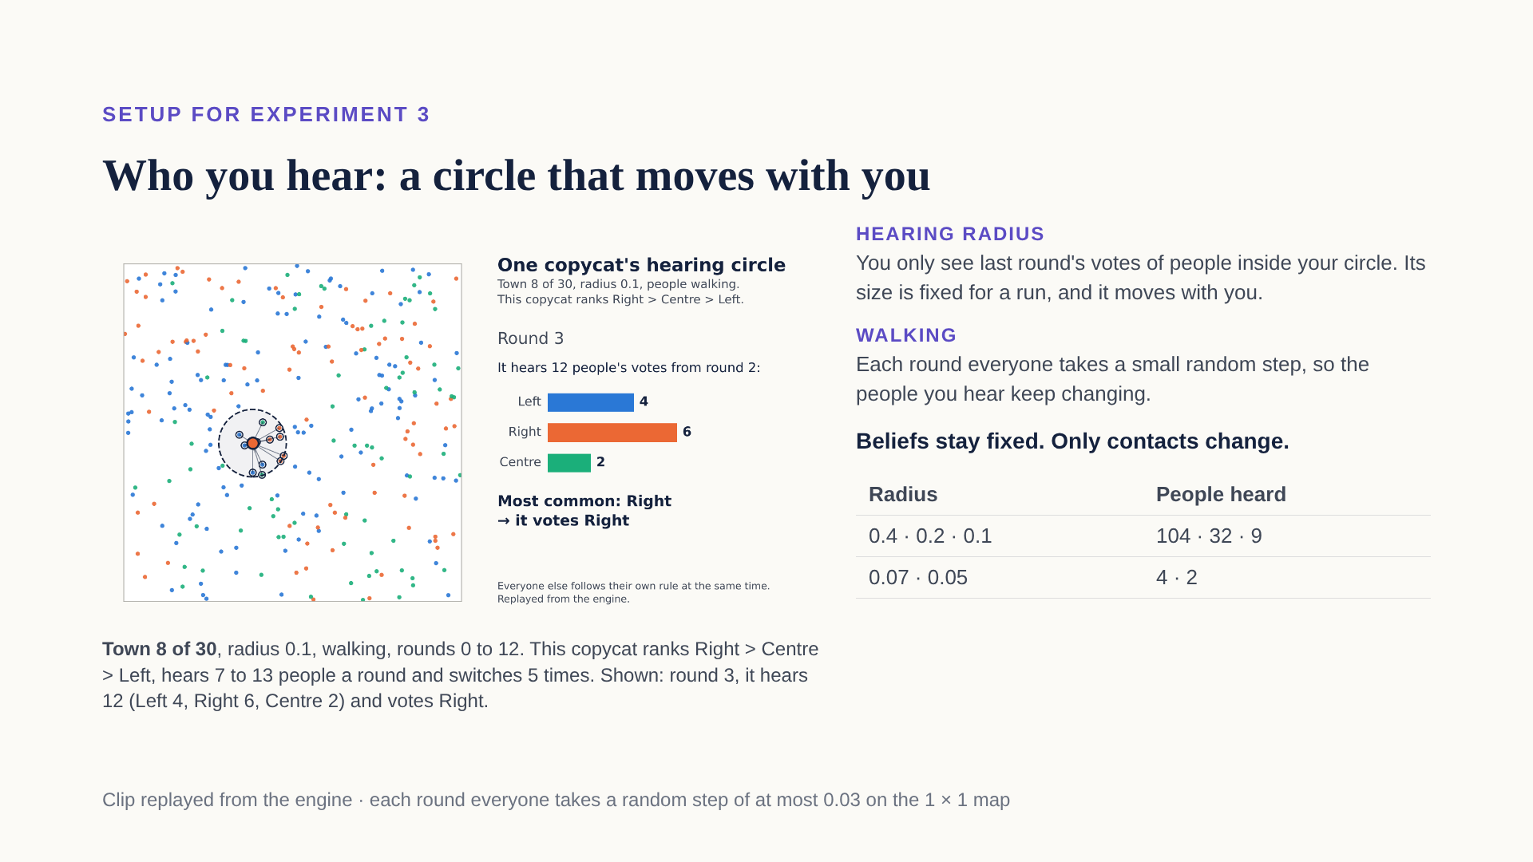
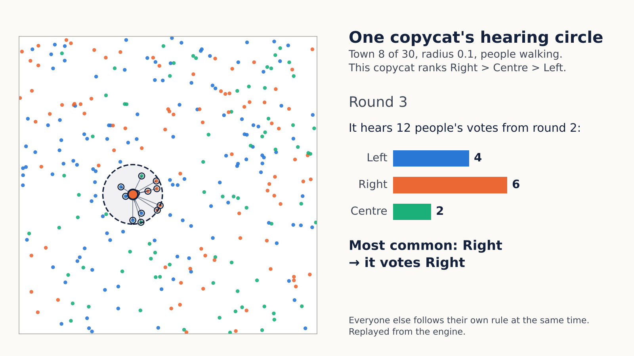
Notes:
Before Experiment 3 we add two things, and this clip shows both. First, the hearing radius. Each voter now only sees last round's votes of the people within a circle around them on the map. The circle has the same size for everyone during a run, and it moves with the person. At radius 0.1 people hear about 9 others on average; at 0.4 about 104; at the smallest, 0.05, about 2. Second, walking. Every round everyone takes a small random step, so who is inside your circle keeps changing. Follow the voter with the big dot and the dashed circle; it is a copycat. Each round everyone steps, then it looks at last round's votes of the people now inside its circle, the ones with rings and lines. The bars on the right count them, and it copies the most common one. In this frame it hears 12 people, 6 of them voted Right, so it votes Right. A few rounds later it is somewhere else, hears different people, and may switch. This voter ranks Right first, then Centre, then Left. Over the 12 rounds in the clip it hears between 7 and 13 people and changes its vote 5 times, without ever changing its mind. Everyone else does the same thing at the same time, each with their own rule. Important: beliefs never change. Nobody changes their mind about the candidates. The only thing that changes is who they hear.

Slide 9
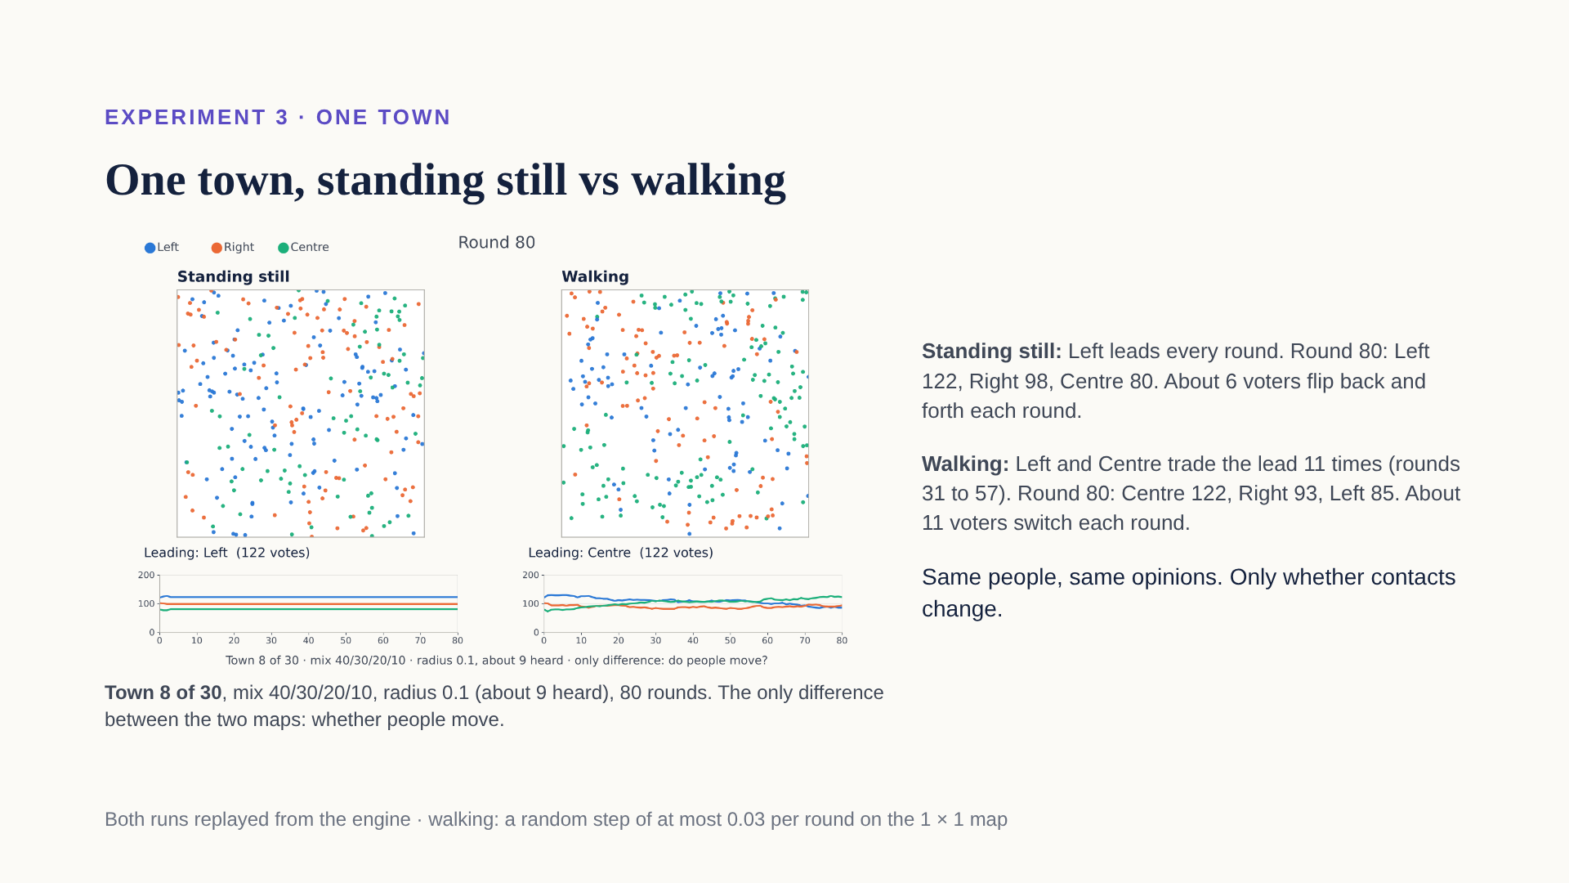
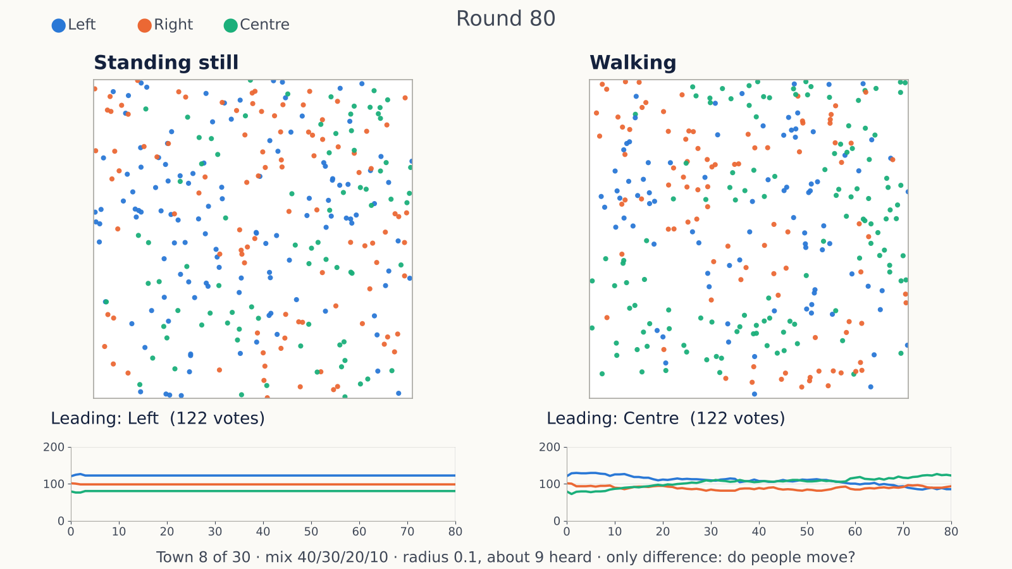
Notes:
Here is Experiment 3 in a single town before the statistics. Same 300 people, same opinions, same hearing radius of 0.1, so about 9 people heard. The only difference between the two maps is whether people move. On the left they stand still. Your neighbours never change, so after a few rounds the colours freeze. Some voters may flip back and forth every other round, but the counts settle and Left stays ahead. That matches a known result for copy-your-neighbours networks: with fixed contacts, things end fixed or in a two-step flip-flop. On the right they walk. Every round the neighbourhoods reshuffle, so people keep seeing different local majorities and keep re-deciding. Look at the count lines under the maps: on the left they go flat; on the right they keep wandering: Left and Centre trade the lead several times, and by round 80 Centre is ahead. So the same town, with nobody changing their mind, can end up with a different leader just because who talks to whom keeps changing. The numbers at round 80: standing still, Left 122, Right 98, Centre 80; walking, Centre 122, Right 93, Left 85. Next slide: does this hold across all 30 towns?

Slide 10
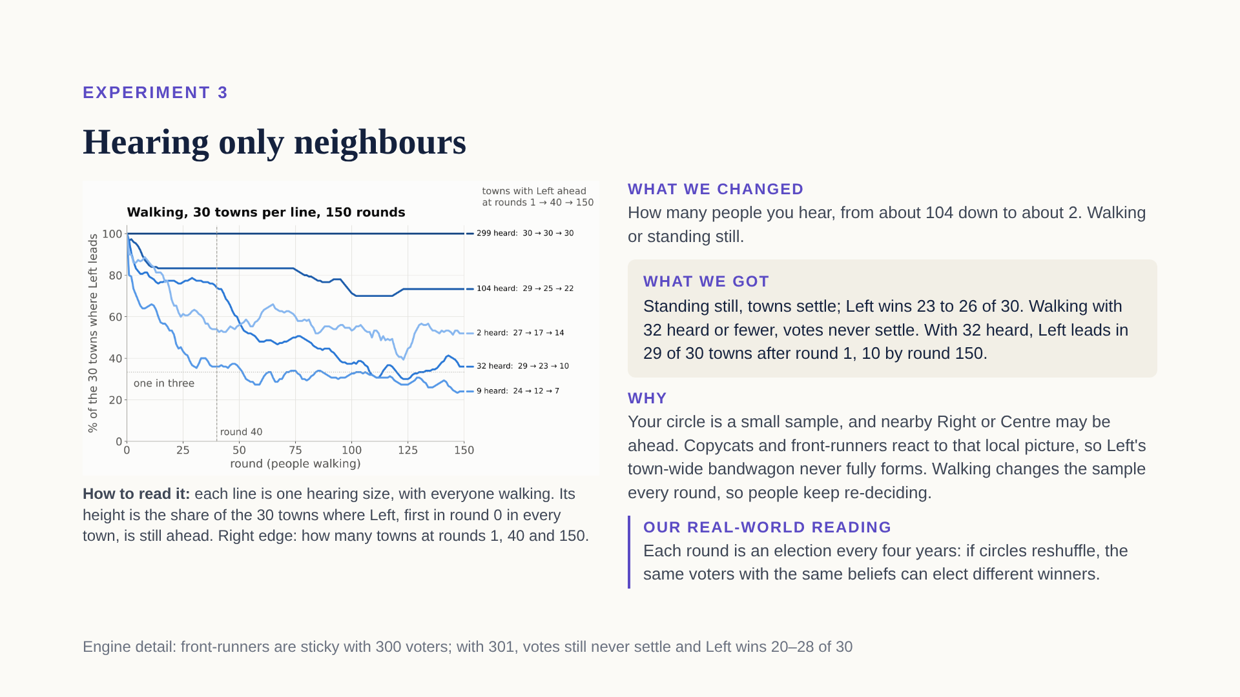
Notes:
Now all 30 towns. Remember the setup: each voter only hears the people inside a circle around them. The circle has a fixed size for the whole run and moves with the person. Beliefs never change; the only thing that can change is who is inside your circle, and that only happens if people walk. We tried five circle sizes, from about 104 people heard down to about 2, each once with people standing still and once with people walking. We expected only noisier results. Instead we got two different worlds. Standing still: your circle never changes, so you keep reacting to the same few people, and the town settles within a few rounds: 149 of 150 runs end fixed or in a two-round flip-flop, and Left still wins 23 to 26 of the 30 towns at every circle size. Walking: here is how to read the chart. Each line is one circle size, with everyone walking. Its height is the share of the 30 towns where Left is ahead, round by round. Left is first in round 0 in every town, so every line starts high. With everyone heard, the top line, Left stays ahead everywhere, forever: that is Experiment 1. With about 104 heard it mostly holds. With about 32 heard, Left leads in 29 of 30 towns after round 1, 23 by round 40, and only 10 by round 150, when each candidate leads 10 towns. With 9 heard it falls from 24 towns to 7, and with 2 heard from 27 to 14. And the votes never settle: in a typical late round, 1 to 7 percent of voters switch. Why? Think of your circle as a small sample of the town, and a small sample can look very different from the whole. In Experiment 1 everyone saw the same count with Left on top, so every copycat piled onto Left. Now a copycat standing among Right voters sees Right on top and copies Right. And a front-runner who is a Right fan, but sees Left and Centre on top in their circle, moves to Centre, not to Left. So the town-wide bandwagon never fully forms. Centre is no longer squeezed either: wherever it looks like one of the top two nearby, it keeps its tactical voters, so it holds about 80 to 106 votes instead of 41. Why walking never settles: every round you take a step, a few people leave your circle and a few join, so the count you react to changes and you re-decide. Your new vote then changes what your neighbours see. Nobody changes their mind, but the votes keep moving, and over many rounds the lead drifts away from Left. Real-world reading: treat each round as an election, say every four years. Between elections people move house, change jobs and follow different people online. If their circles reshuffle, the same electorate with the same beliefs could elect a different winner each time. One honest caveat, in the footer: with 300 voters, the engine's front-runners happen to stick with a candidate while it stays in the top two. With 301 voters they don't stick; the votes still never settle, and Left wins 20 to 28 of 30 towns at round 40.

Slide 11
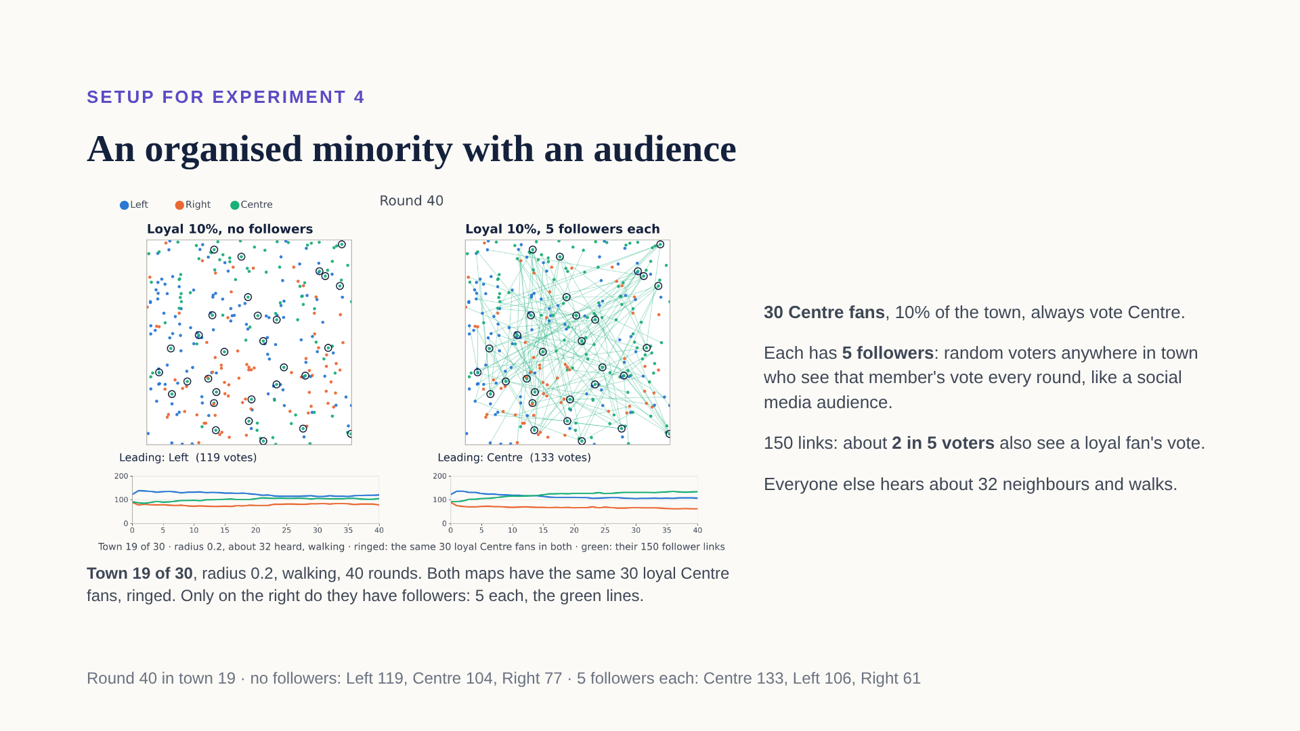
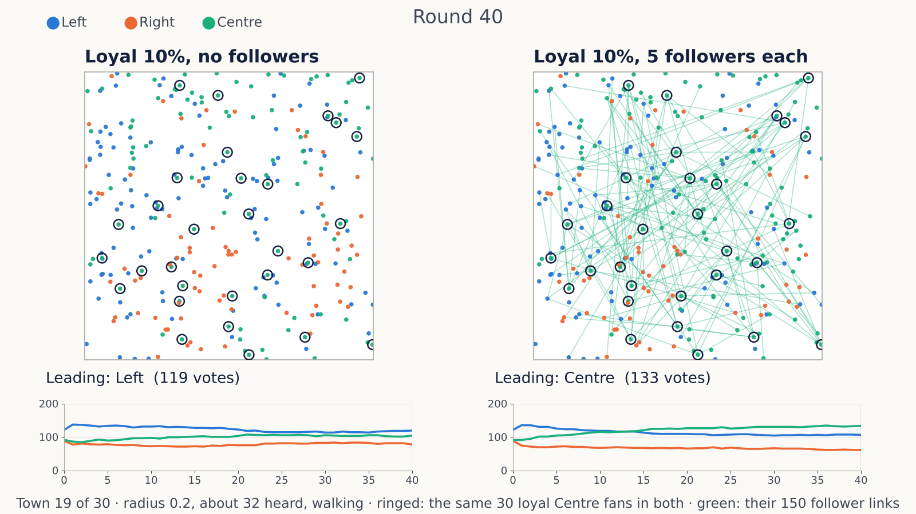
Notes:
For the last experiment we add one more ingredient: an organised minority. We take 30 of Centre's own fans, 10 percent of the town, and make them loyal: they always vote Centre, whatever they see. Then we give each of them followers. A follower is a random voter anywhere in town who sees that member's vote every round, on top of their normal neighbours. Think of a social media account: people far away still see what you post. Everyone else is exactly as in Experiment 3 at radius 0.2: they hear about 32 neighbours and walk around. How big is the audience? Small on purpose: just 5 followers per loyal fan. That is 150 links in a town of 300, so about 2 in 5 voters see a loyal fan's vote each round, on top of the roughly 32 people they hear nearby. That is the propaganda: a single extra Centre vote in some people's view. In the clip both maps are the same town, number 19, with the same 30 loyal fans, ringed. The only difference: on the right, each of them has 5 followers, the green lines. Watch the count lines under the maps. On the left, loyalty alone keeps Centre in the race, but Left leads every single round and ends with 119 votes to Centre's 104. On the right, Centre creeps up, draws level with Left in round 13, 116 each, leads from round 14 and ends with 133, against Left's 106. Notice what the group does not do: it does not change anyone's opinion, and it does not need to know more. It just gets its votes seen by a few more people. Next slide: what happens across all 30 towns.

Slide 12
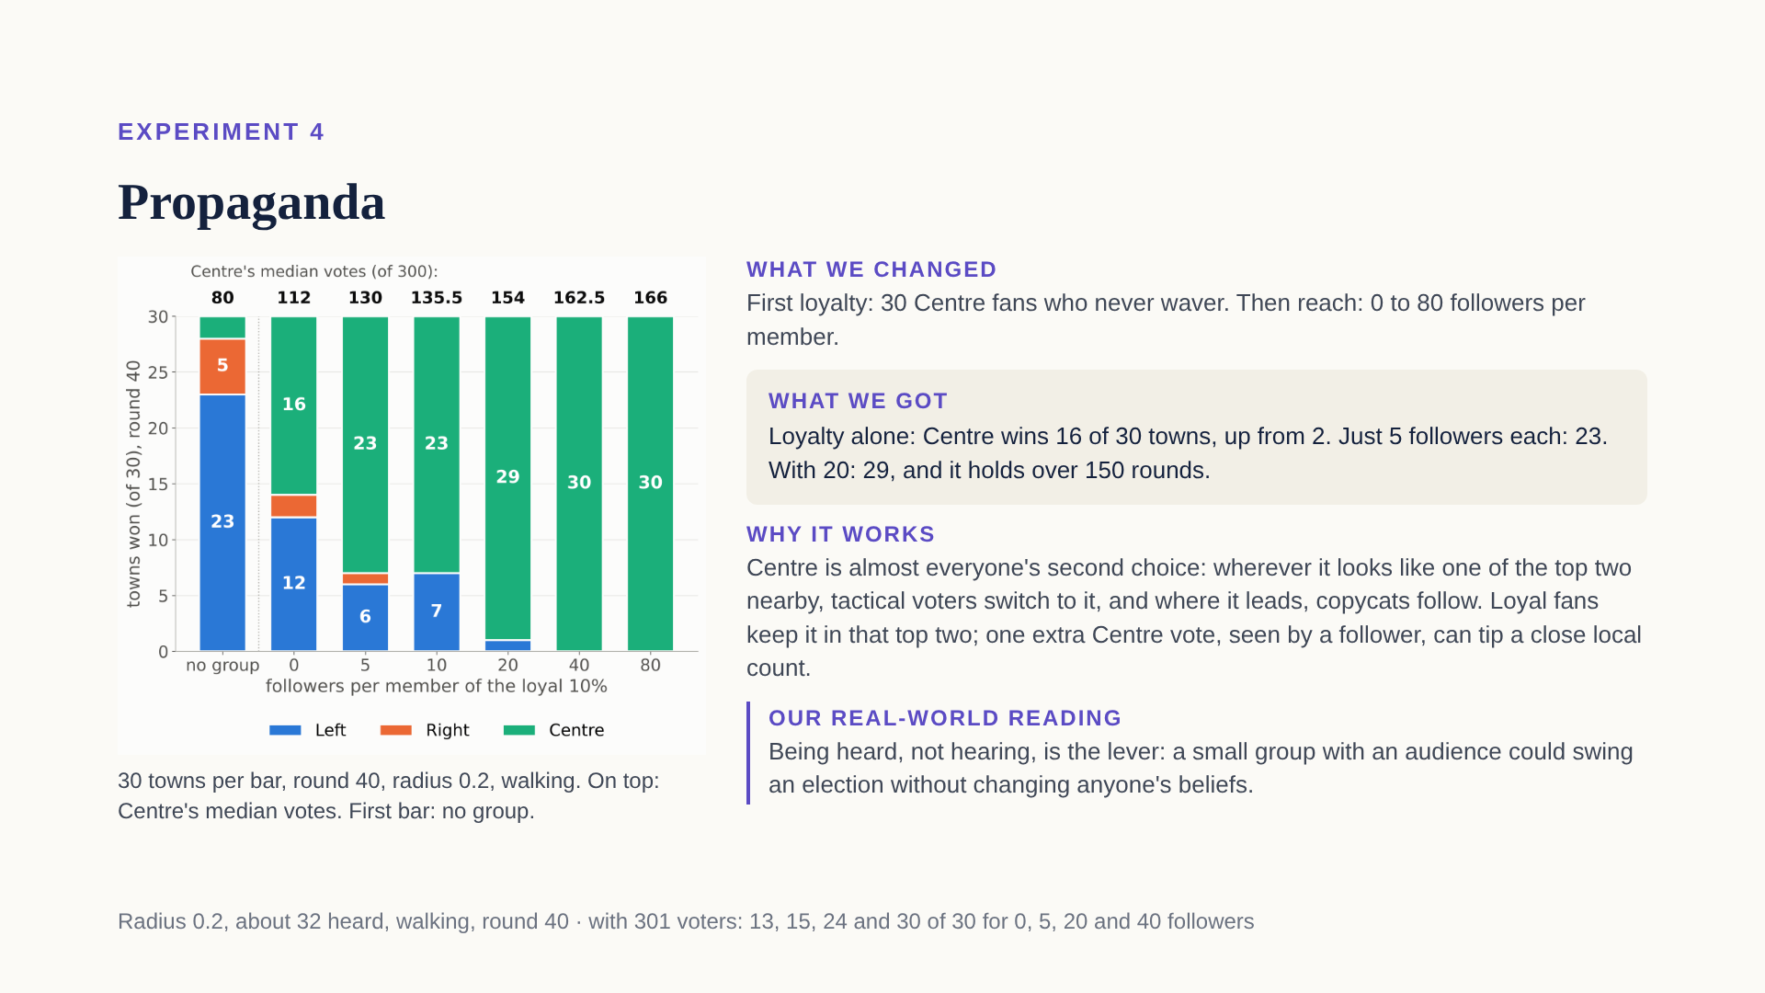
Notes:
Here are all 30 towns at round 40, with everyone hearing about 32 neighbours and walking, as in Experiment 3. The first bar has no organised group: Left wins 23, Right 5, Centre only 2. To see why the group matters, remember one fact from the start of the talk: Centre is almost everyone's second choice. Almost all Left fans prefer Centre to Right, and almost all Right fans prefer Centre to Left. So whenever Centre looks like one of the top two in someone's circle, the tactical voters whose favourite looks out of the race switch to Centre. And copycats copy whatever leads in their circle. Without help, Centre takes an early hit: in round 1 many of its own tactical fans see Left and Right on top nearby and leave, and its median drops from 83 votes to about 70. It recovers a little, to about 80, but it stays out of the top two in most circles and wins only 2 towns. Step one, loyalty alone, zero followers: 30 of Centre's fans never leave. That stops the early slide: Centre's median only dips from 83 to 81 in round 1. So Centre stays in the local top two in more circles, the tactical votes start flowing to it, and it grows to a median of 112 by round 40. Centre wins 16 towns instead of 2. Step two, reach. Each loyal fan gets followers: random people anywhere in town who see that fan's vote every round. With just 5 followers each, that is 150 links, and about 2 in 5 voters see a loyal fan's vote. One vote sounds like nothing. But in a circle of about 32 people where the count is close, one extra Centre vote can lift Centre into the top two, or into first place. Then the tactical voters and copycats in that circle switch, and their new votes are heard by their own neighbours. With 5 followers each, Centre never dips at all: 86 votes after round 1, 130 by round 40. So Centre wins 23 towns with 5 followers each, 29 with 20, and all 30 with 40 or more. The numbers on top of the bars are Centre's median votes: 80 with no group, 112 with loyalty alone, 130 with 5 followers, 154 with 20. The people who switch are almost all front-runners and copycats. And it lasts: in 150-round runs with 20 followers, Centre wins every town in every round from round 50 on. Note what the lever is: being heard, not hearing. The loyal fans never change their vote, so hearing more would do nothing for them. What matters is how many people see them. The footer has the robustness check: with 301 voters, where front-runners are not sticky, the direction is the same, but a small audience helps less: 13 towns with no followers, 15 with 5, 24 with 20, 30 with 40. Our real-world reading: a small organised group with an audience, like a network of accounts on social media, could swing an election without changing anyone's beliefs, just by changing what people see. A question for the audience: here the group pushed the compromise candidate, the one most people prefer head to head. Is that manipulation bad?

Slide 13
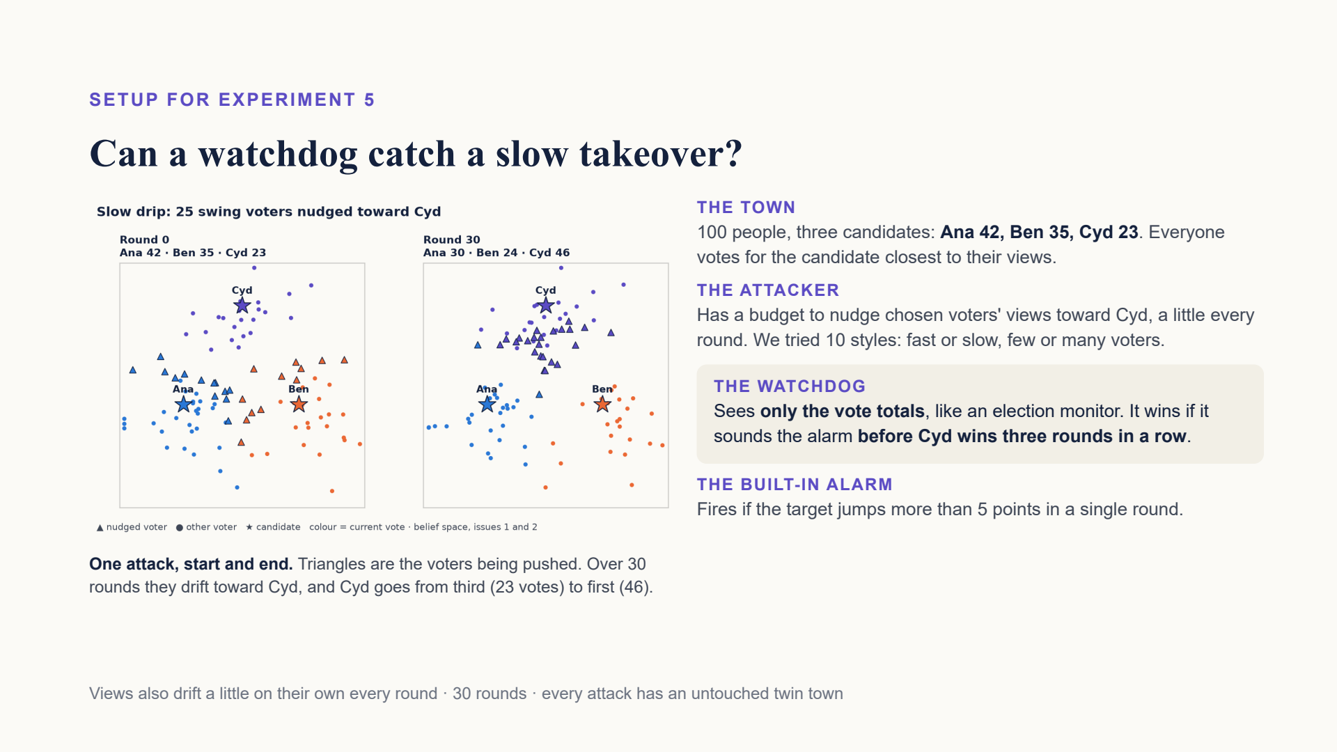
Notes:
100 people, three candidates. Cyd starts third with 23 votes. An attacker has a budget to nudge chosen voters' beliefs toward Cyd, a little each round. The watchdog never sees beliefs or the attacker, only the vote totals each round, like an election monitor. It wins if it raises the alarm before Cyd wins three rounds in a row. The built-in alarm fires when the target jumps more than 5 points in one round.

Slide 14
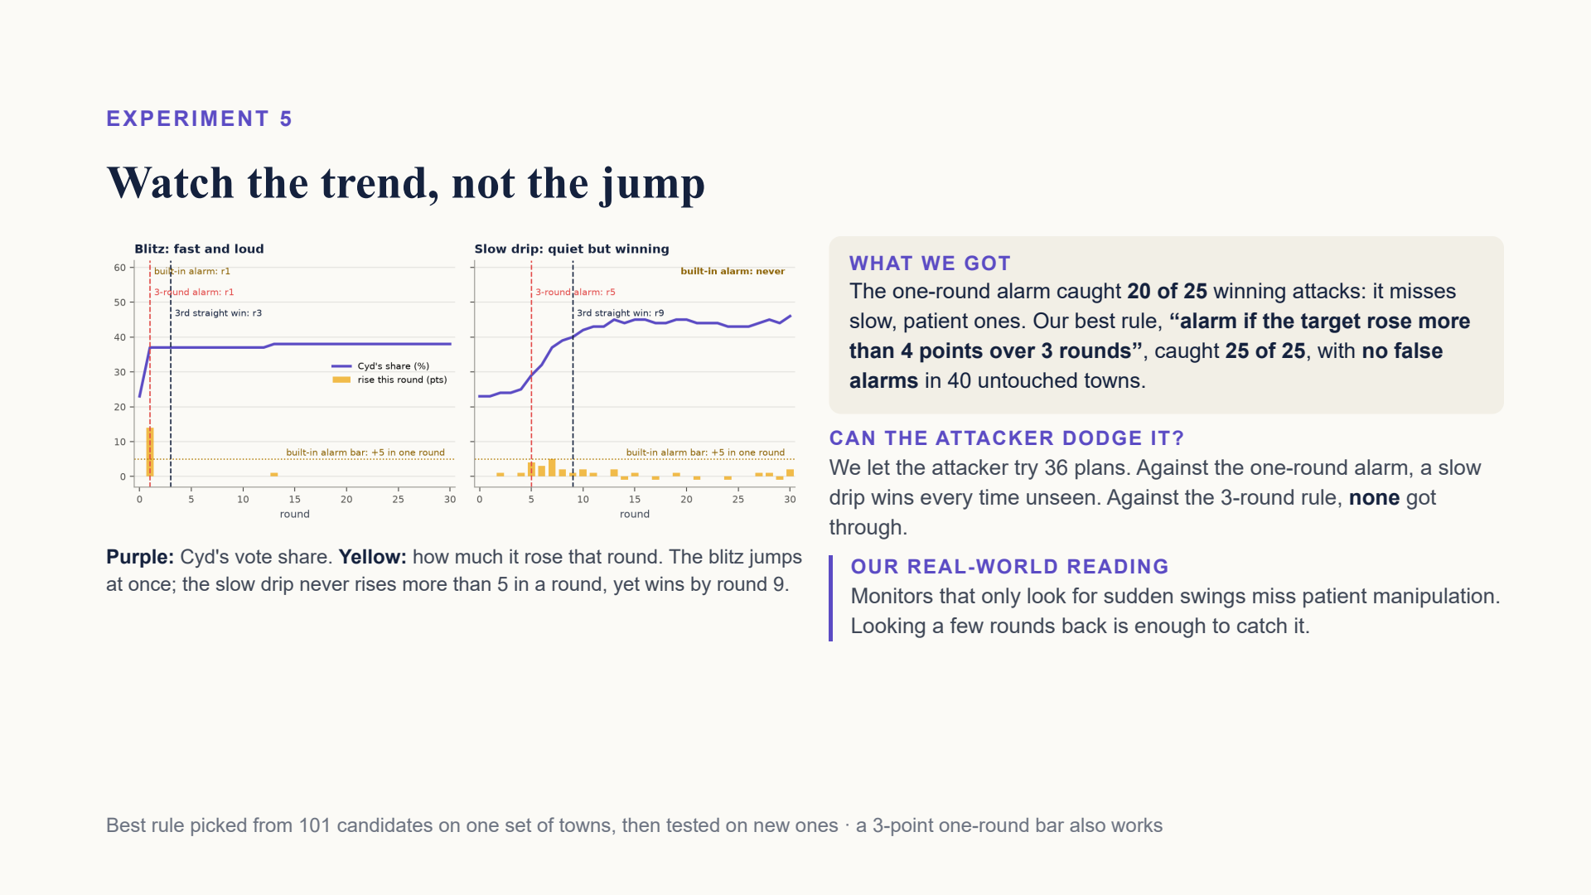
Notes:
Fast attacks are loud: Cyd jumps 10 to 14 points in one round and the built-in alarm catches them. Slow attacks add only 4 or 5 points a round, never enough to trip a one-round alarm, yet they still win by round 9 or 10. The built-in alarm caught 20 of 25 winning attacks on new test towns. We tried 101 rules that use only the totals. The best: alarm if the target rose more than 4 points over the last 3 rounds. It caught 25 of 25 with zero false alarms in 40 untouched towns. We then let the attacker try 36 plans; none won without being caught first. Lowering the one-round bar to 3 points also works.

Slide 15
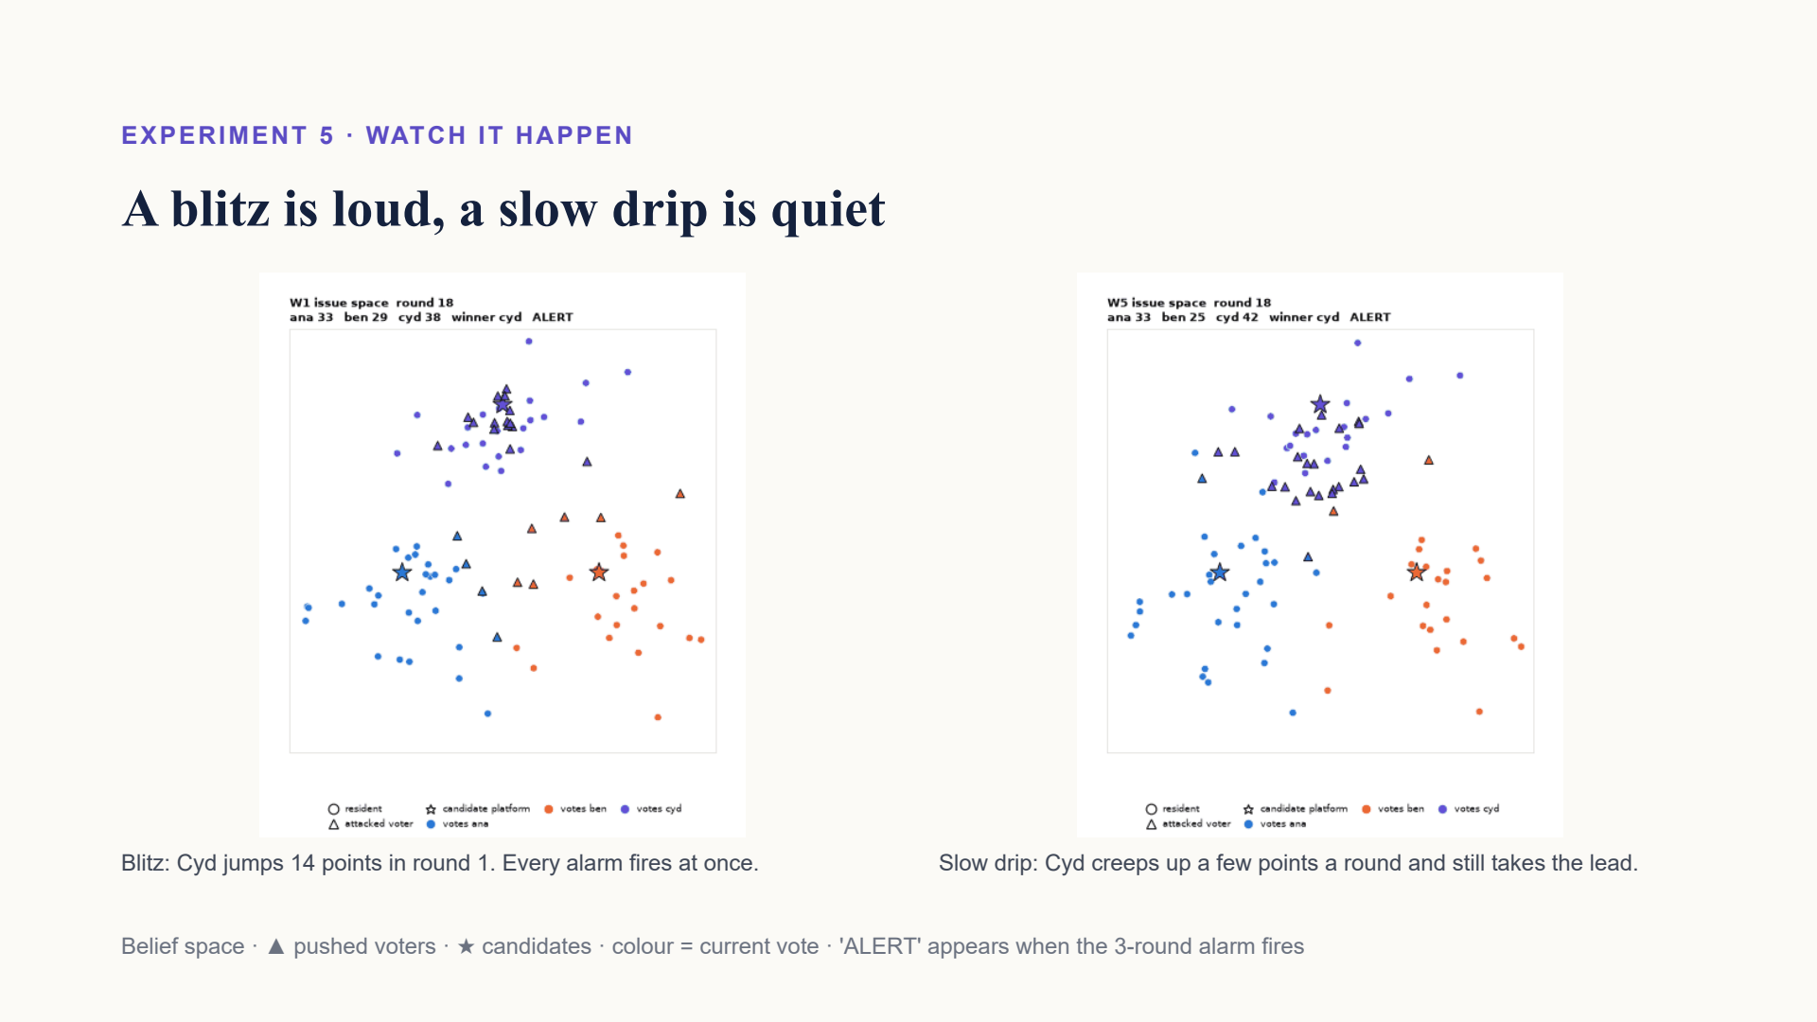
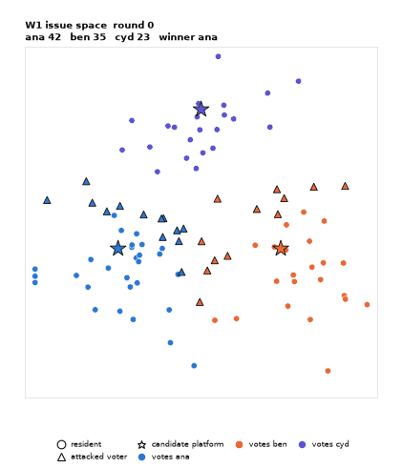

Notes:
Left: a blitz. Many triangles move toward Cyd at once and the colours flip in round 1. Right: the slow drip, in a noisier town. Nothing dramatic happens in any one round, but by round 10 Cyd is ahead. That is exactly why the watchdog has to look at a trend, not a single jump.

Slide 16
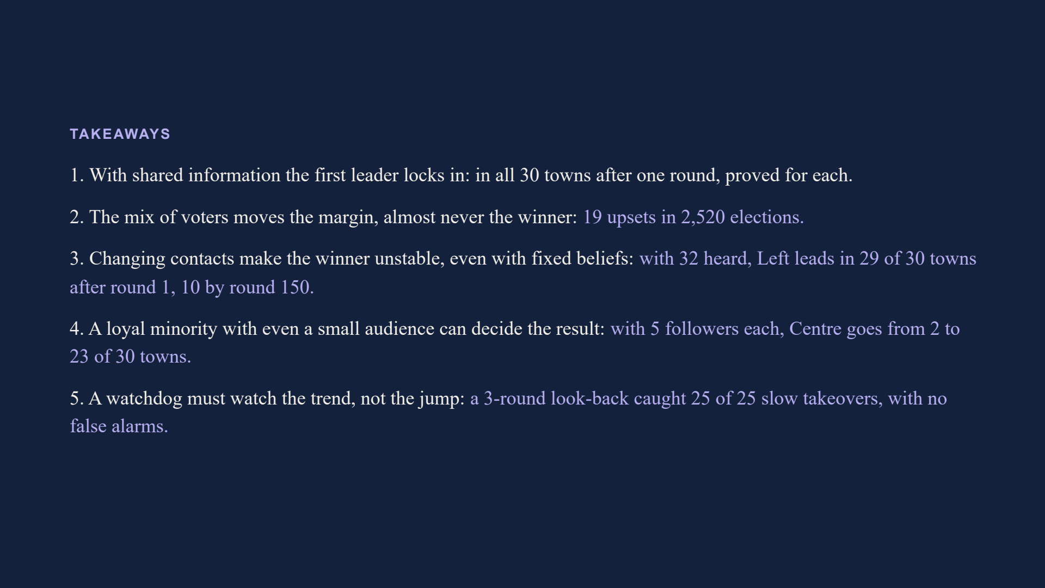
Notes:
Four things to remember. One: when everyone sees the same count, strategic voting locks in whoever leads the first count; in all 30 of our towns we can prove it stops after one round, although near-ties can loop forever. Two: changing the mix of voter types changes how big the win is, and almost never who wins: 19 upsets in 2,520 elections. Three: when people only hear their neighbours and their contacts keep changing, the result never settles, even though nobody ever changes their mind. Four: a small group that never wavers can win most towns with a small audience, just 5 followers each, and every town with a big one. So, back to our question: the winner does not depend only on what people prefer. It depends a lot on what they can see and who they hear. Five: a watchdog has to watch the trend, not the jump; looking back three rounds caught every slow takeover we tried, with no false alarms.

Slide 17
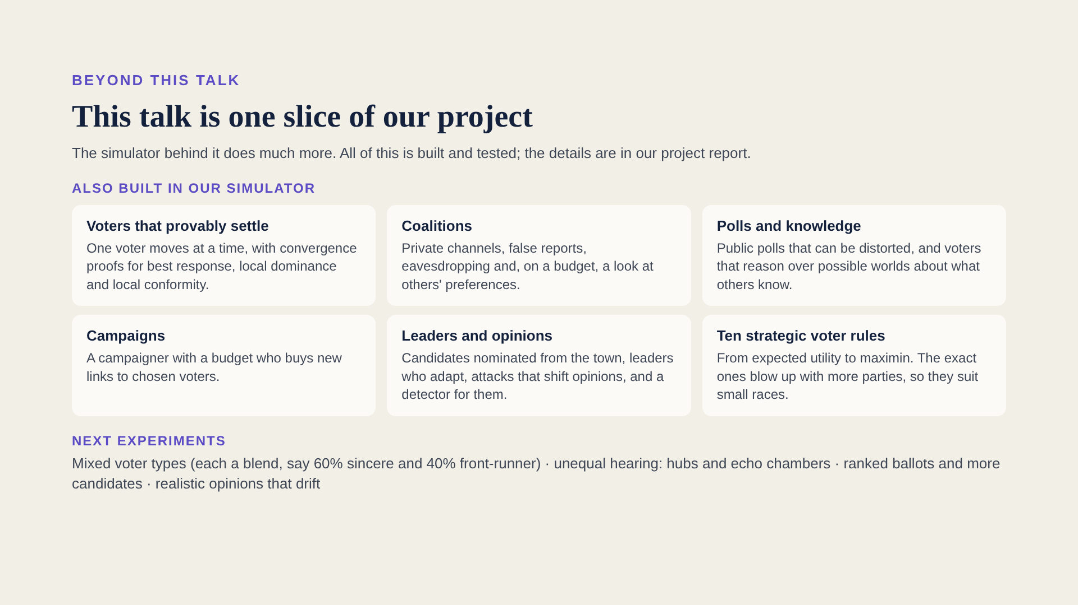
Notes:
Before questions, one honest point. This talk is a deliberately simple slice of our project: one voting rule, four voter types, three candidates and a hearing circle. The simulator our team built does a lot more. All of it is built and tested, and the details are in our project report. First, voters that provably settle. In a special mode where one voter moves at a time, the simulator comes with convergence proofs for three kinds of voters: best response, local dominance and local conformity. So for those runs we know in advance that they must stop. Second, coalitions: groups of voters with private channels who can send false reports, eavesdrop on other people's messages, and, within a budget, see other voters' private preferences. Third, polls and knowledge: a public poll that someone can distort, and voters that reason over possible worlds about what the others know. Fourth, campaigns: a campaigner with a budget who buys new links to chosen voters, a more strategic version of our followers. Fifth, leaders and opinions: candidates nominated from within the town, leaders who adapt their platforms, attacks that shift voters' opinions, and a detector that watches the vote totals for signs of an attack. And ten strategic voter rules beyond our four, from expected utility to maximin. The exact ones, expected utility and the possible-worlds voters, blow up as the number of parties grows, so we keep them for small races. All of this runs with replay, rewind and a live browser view. What we have not done yet is run full experiments on those mechanisms. That, and these next experiments, is where this goes: mixed voter types, where each voter is a blend, say 60 percent sincere and 40 percent front-runner, and the blend can shift with how close the race is; unequal hearing, with hubs and echo chambers; ranked ballots, such as instant runoff and Borda, and more candidates; and realistic opinions that drift towards what people hear. Thank you. Happy to take questions.

Slide 18
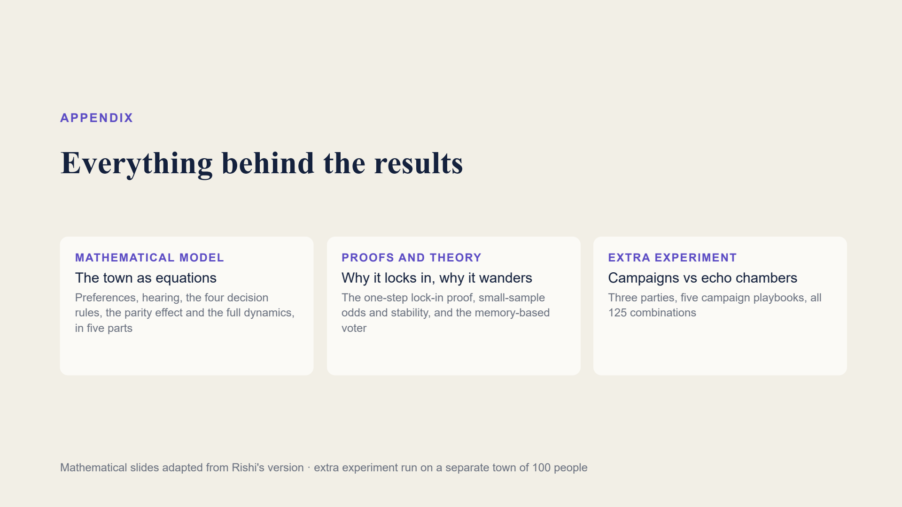
Notes:
The appendix has the full mathematical model and proofs, adapted from Rishi's slides, and one extra experiment on campaigns and echo chambers.

Slide 19
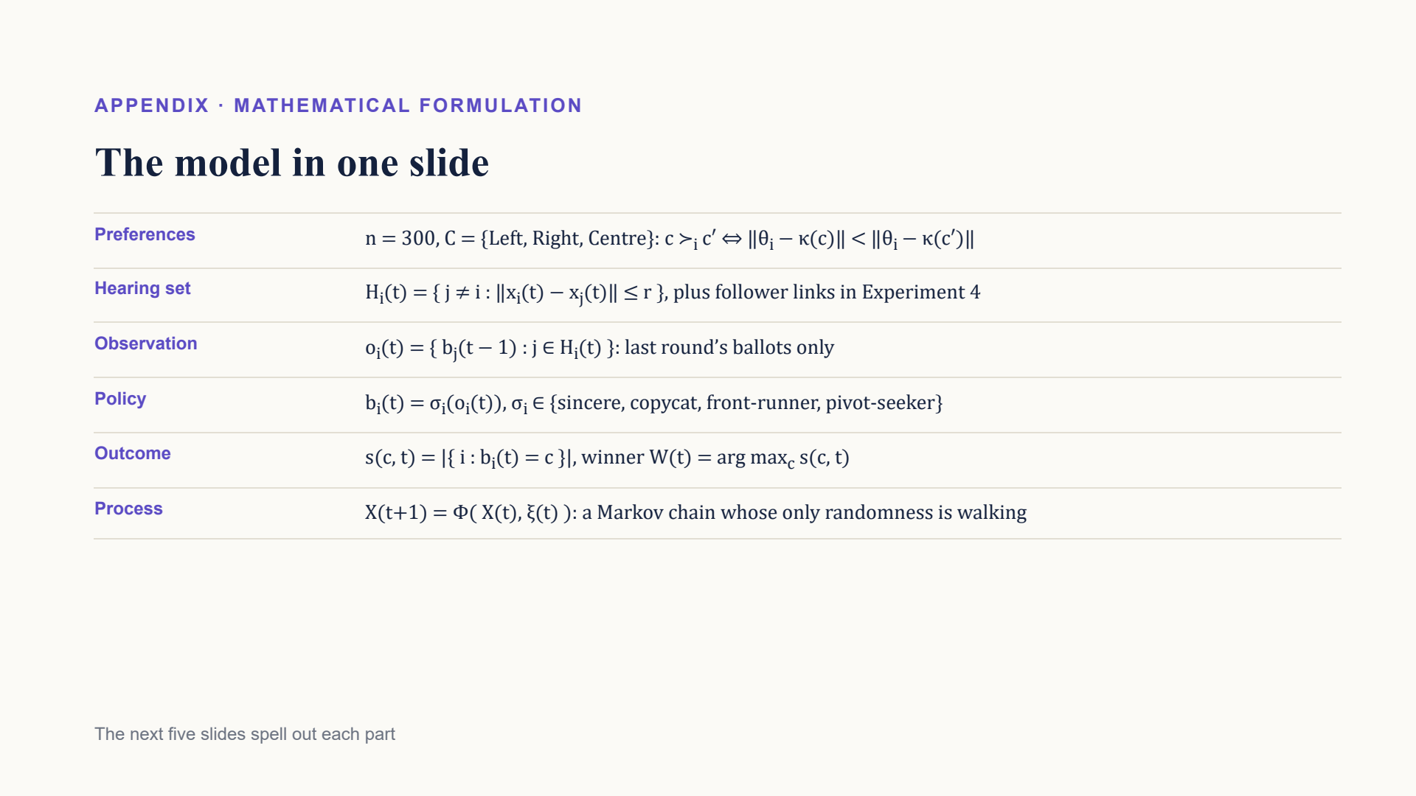
Notes:
The whole model on one slide: fixed preferences from distances in belief space, a hearing set from the map, observations of last round's ballots only, a decision rule per voter, plurality counting, and a Markov chain whose only randomness is walking.

Slide 20
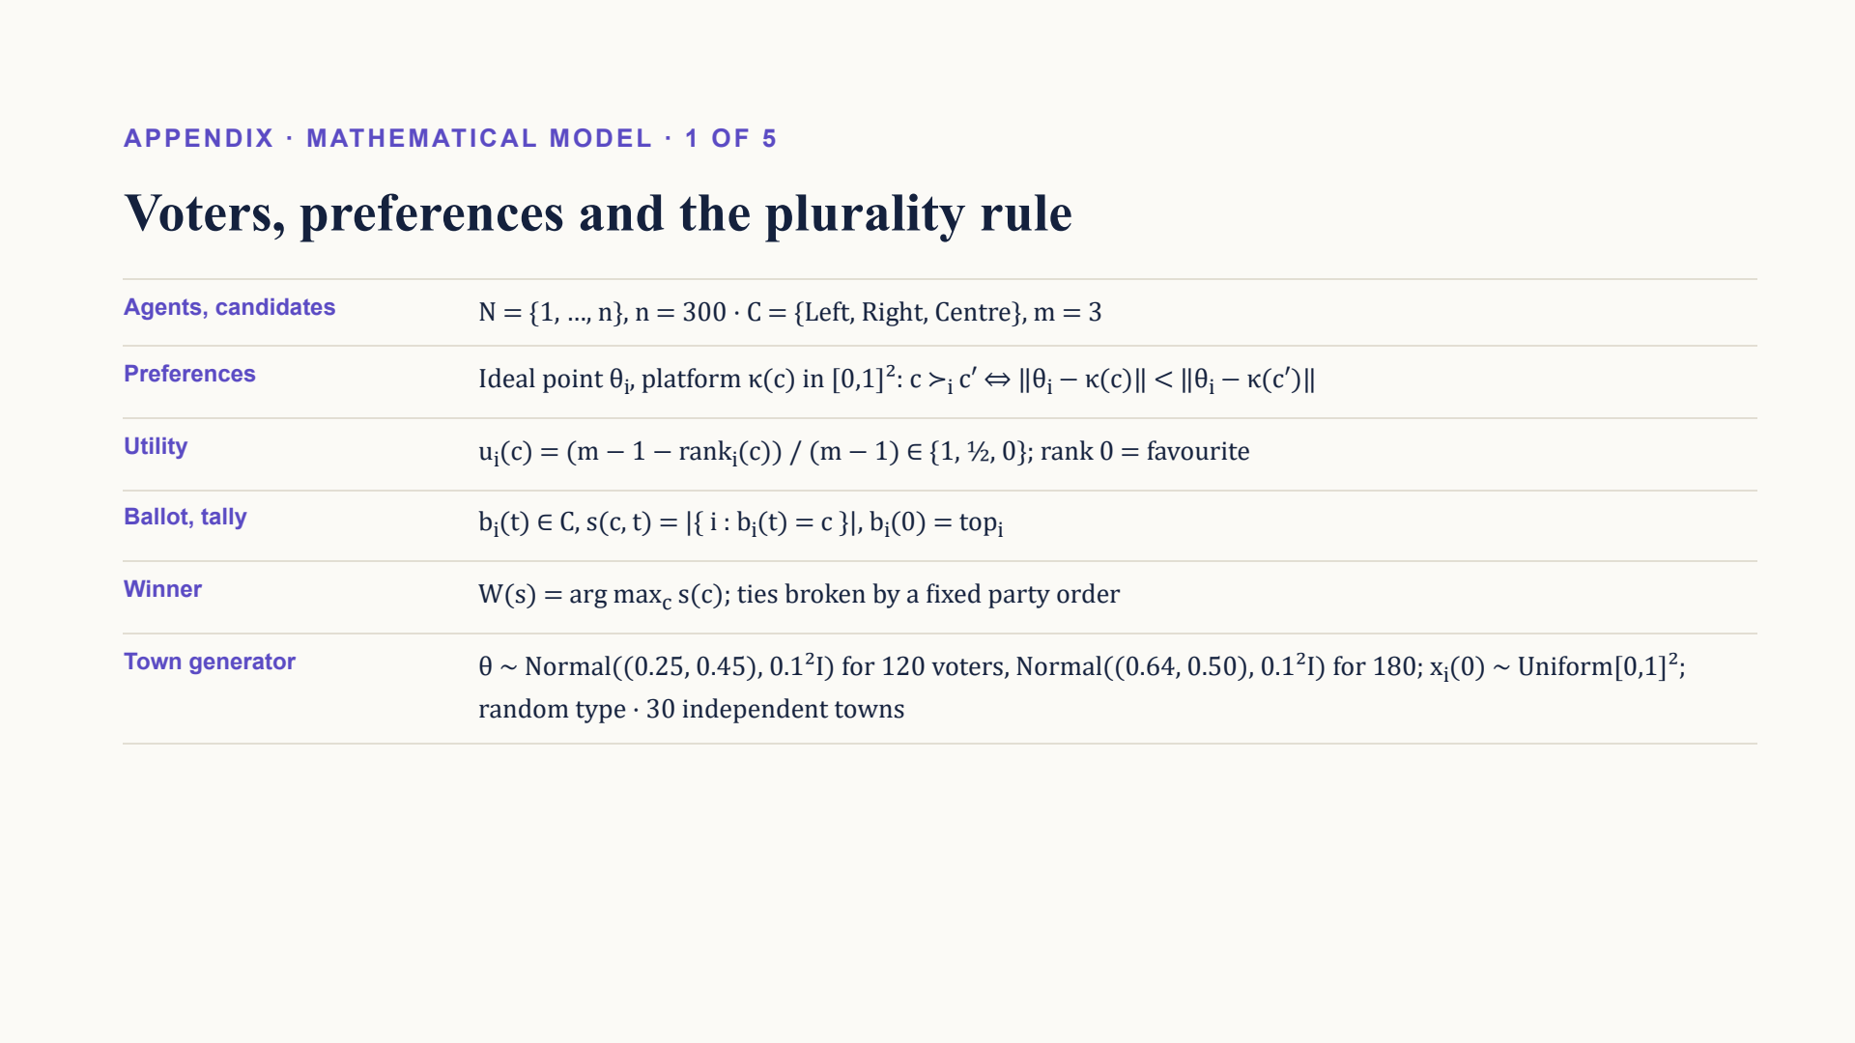
Notes:
Voters and the plurality rule. Each voter ranks candidates by distance in belief space; utility is 1, a half or 0 by rank. Round 0 everyone votes their favourite. Ties go to a fixed party order. Towns are drawn from two camps.

Slide 21
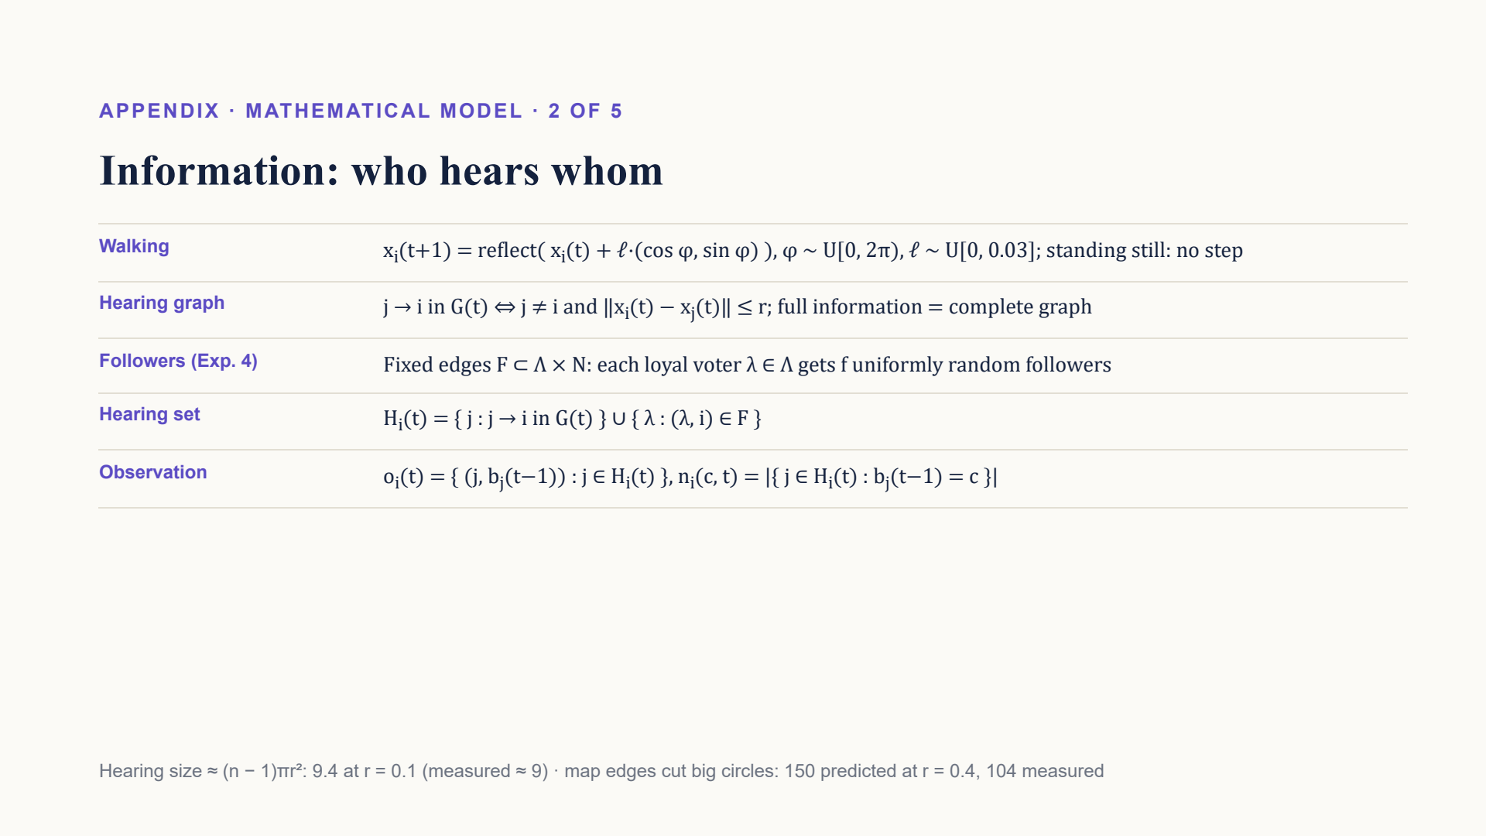
Notes:
Who hears whom. Walking is a bounded random step reflected at the edges. You hear everyone within radius r, plus, in Experiment 4, the loyal voters you follow. Hearing size grows with the circle's area, cut by the map's edges.

Slide 22
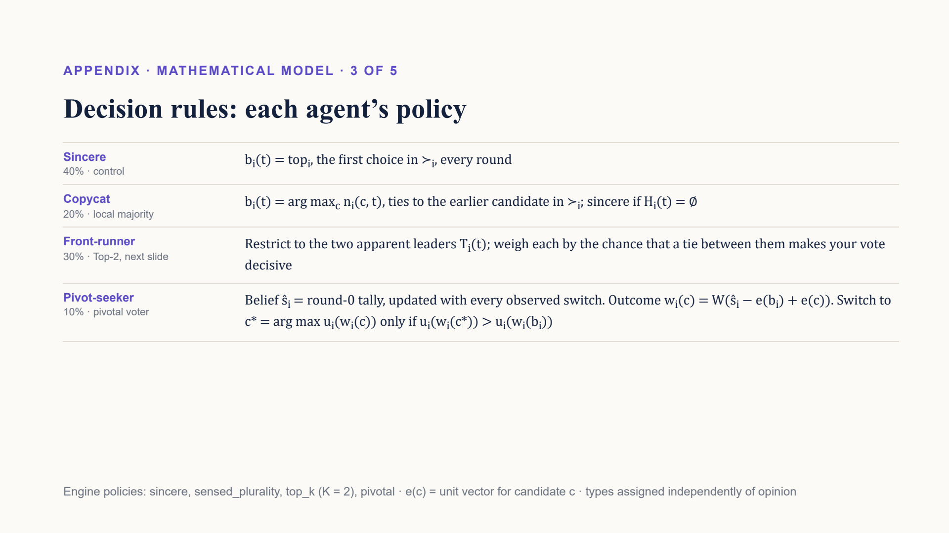
Notes:
The four decision rules as formulas. Sincere never changes. Copycats take the local majority. Front-runners keep only the two apparent leaders. Pivot-seekers keep a belief about the full tally and switch only if their vote changes the winner to someone they prefer.

Slide 23
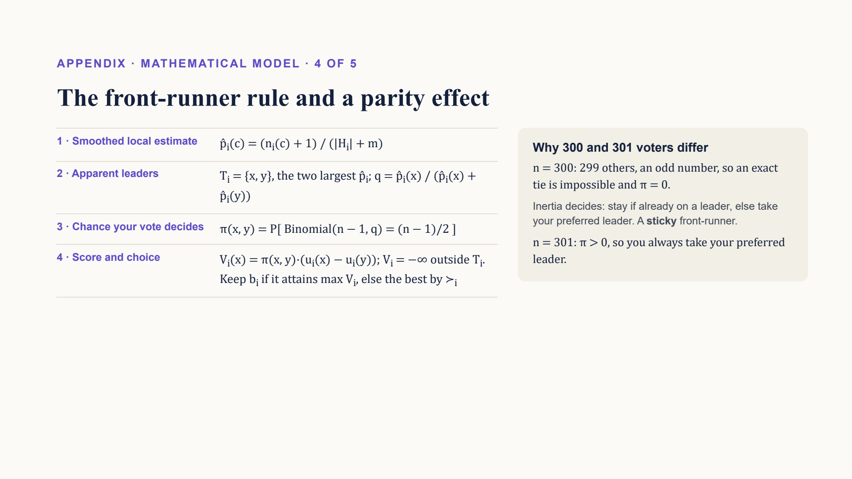
Notes:
How the front-runner chooses, and why 300 voters behave differently from 301: with an even number of voters an exact tie among the others is impossible, so the rule never sees a decisive vote and just keeps its current choice if that is one of the two leaders.

Slide 24
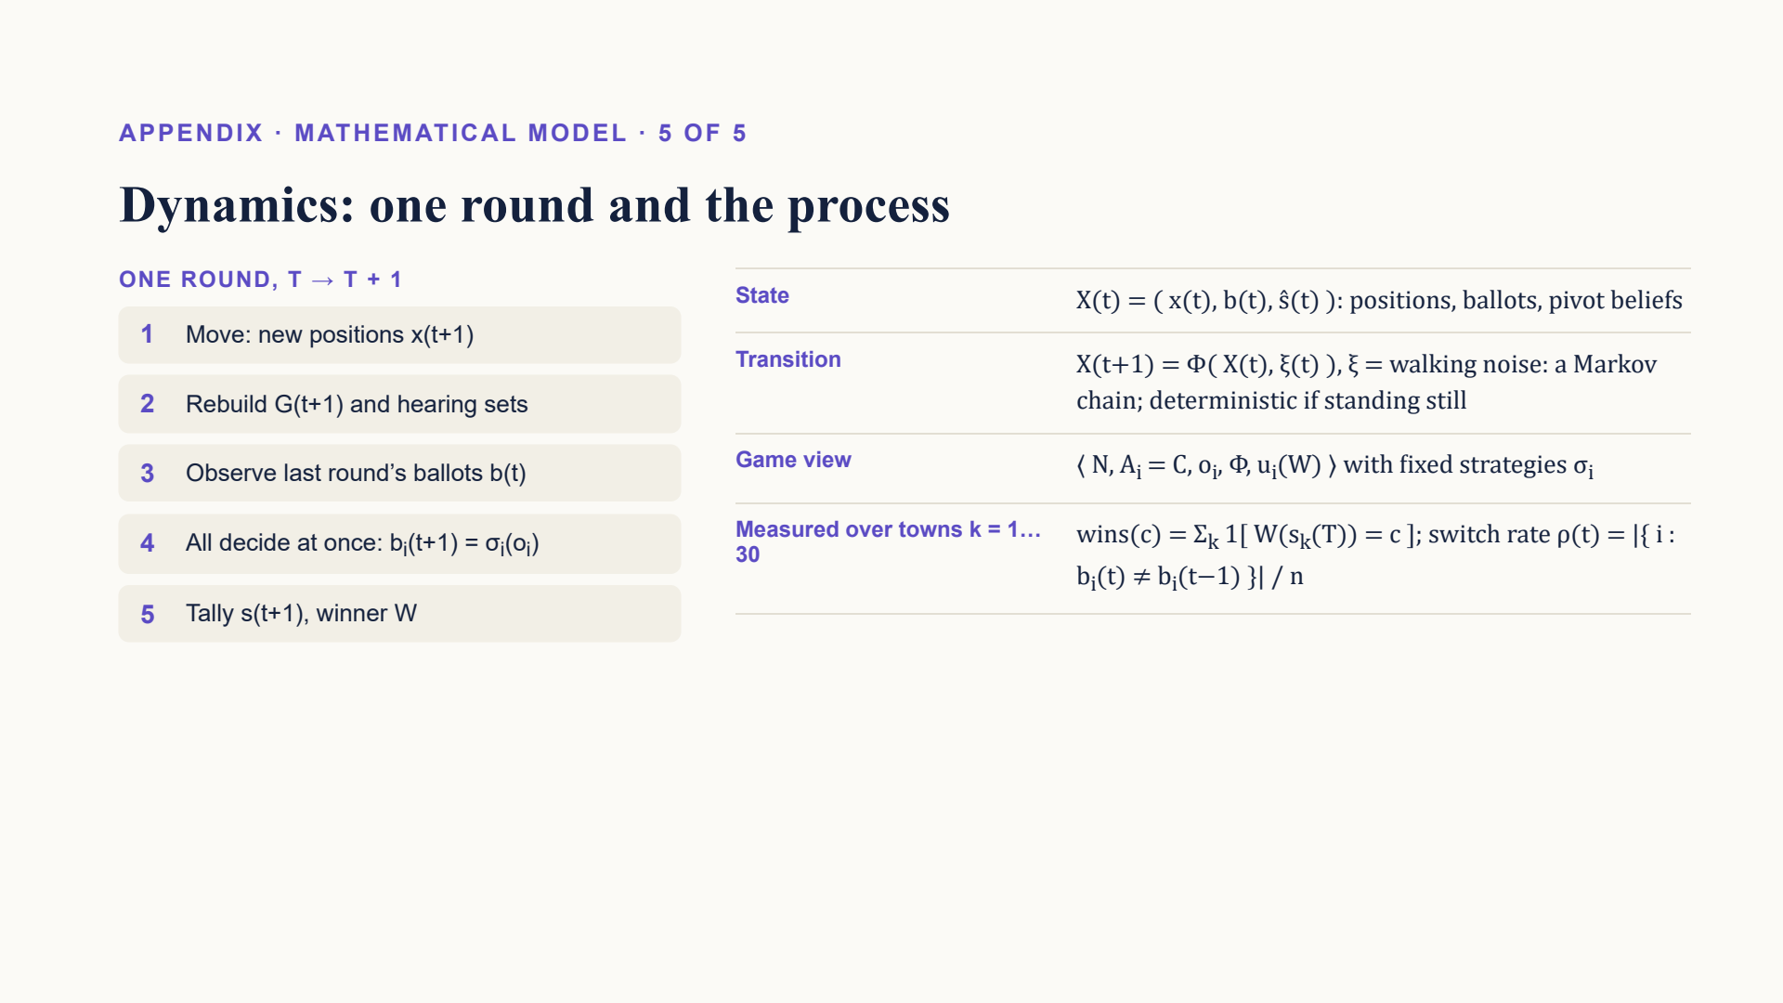
Notes:
One round in five steps, then the whole process as a Markov chain over positions, ballots and beliefs. We measure wins across the 30 towns and the share of voters who switch each round.

Slide 25
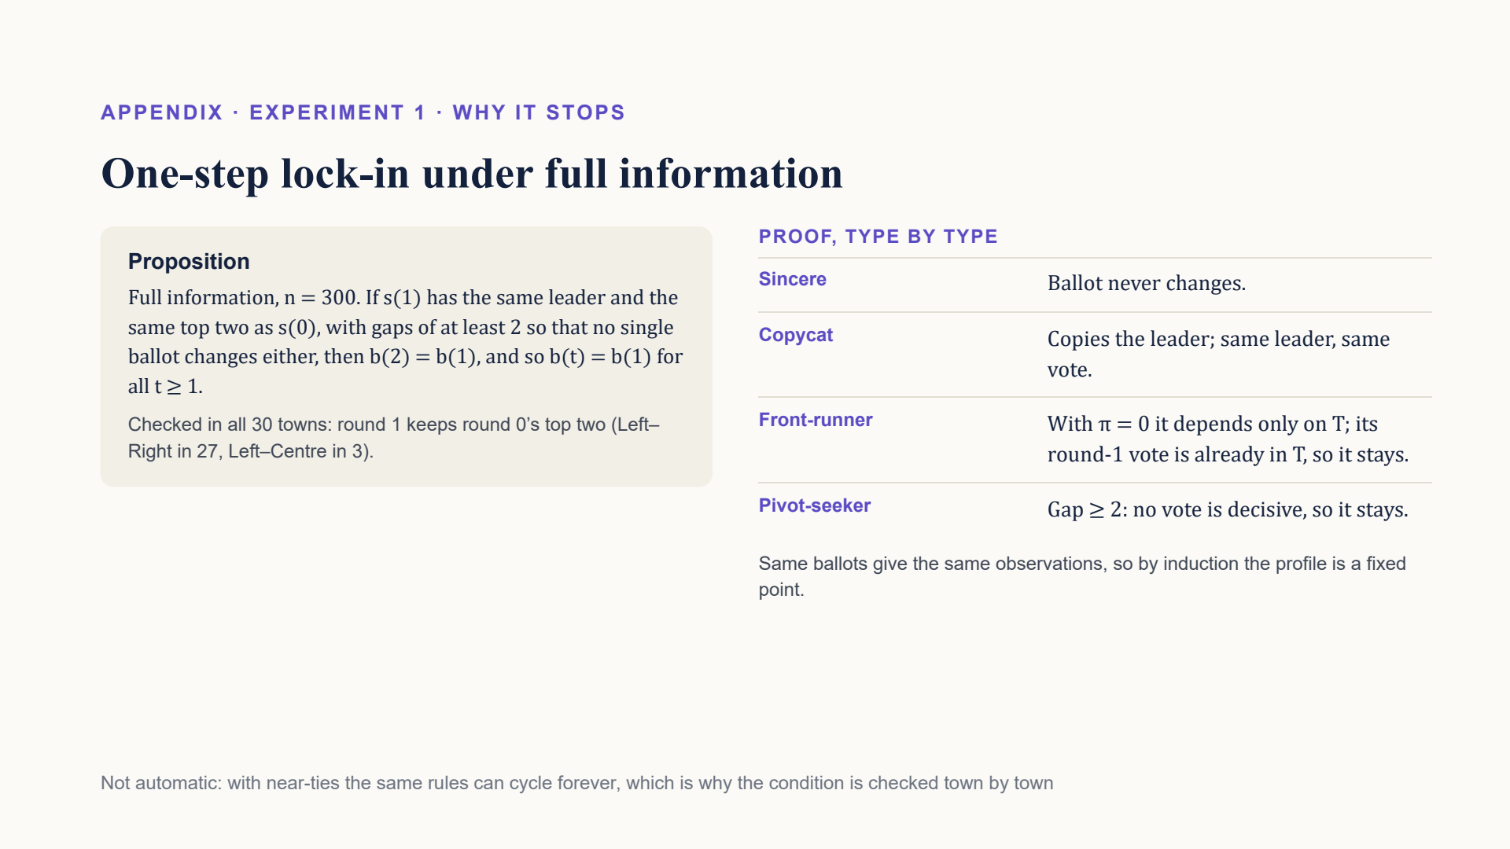
Notes:
Why Experiment 1 freezes. If round 1 keeps the same leader and top two with gaps of at least 2, nobody has a reason to switch again, type by type, so the ballots are a fixed point. The condition is checked in every town.

Slide 26
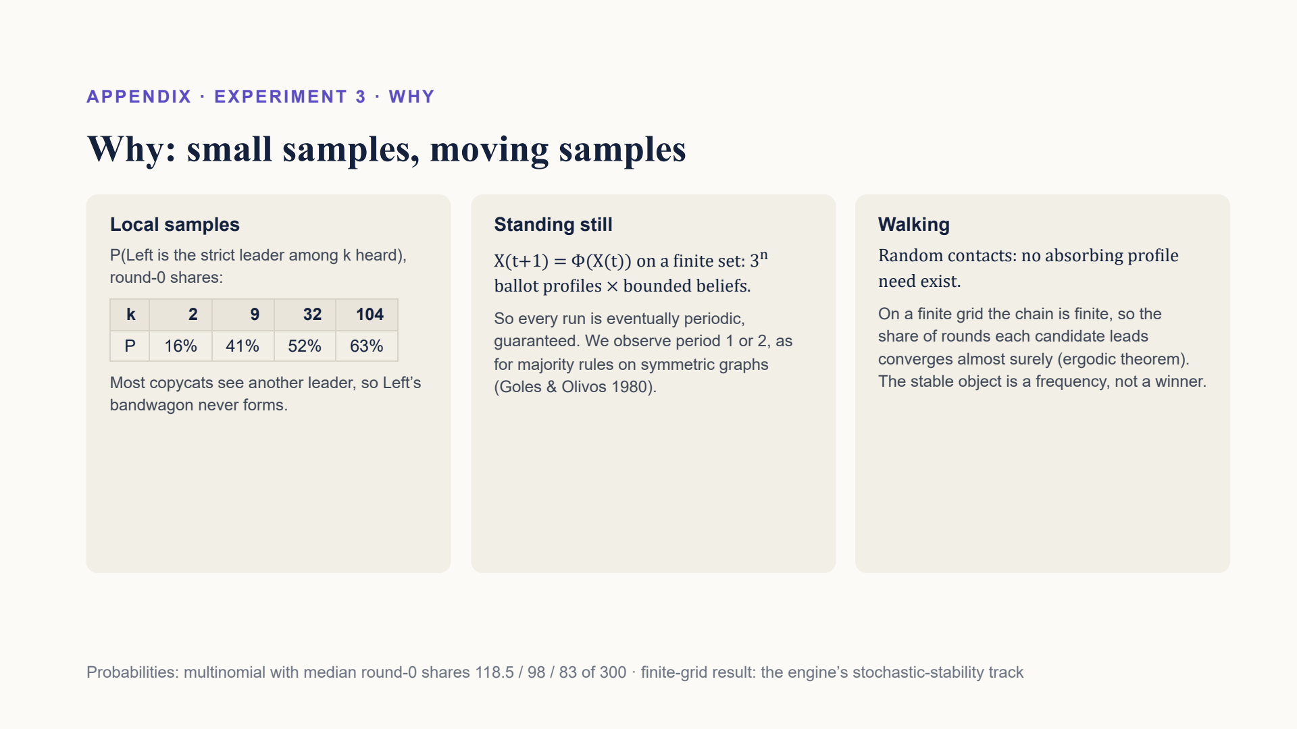
Notes:
Why Experiment 3 wanders. Small hearing samples often show a different leader. Standing still, the system must eventually repeat; walking, there may be no resting state, so the right summary is how often each candidate leads.

Slide 27
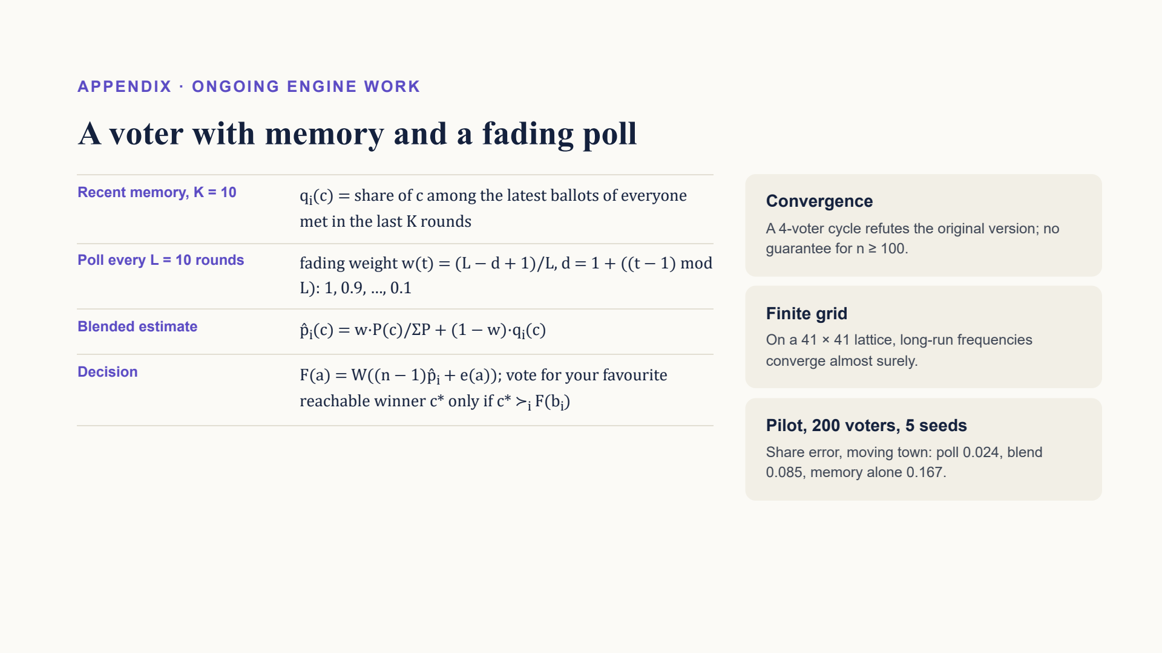
Notes:
Ongoing engine work: a voter who remembers recent contacts and blends that memory with a poll whose weight fades between polls. Early pilot numbers; no convergence guarantee in general.

Slide 28
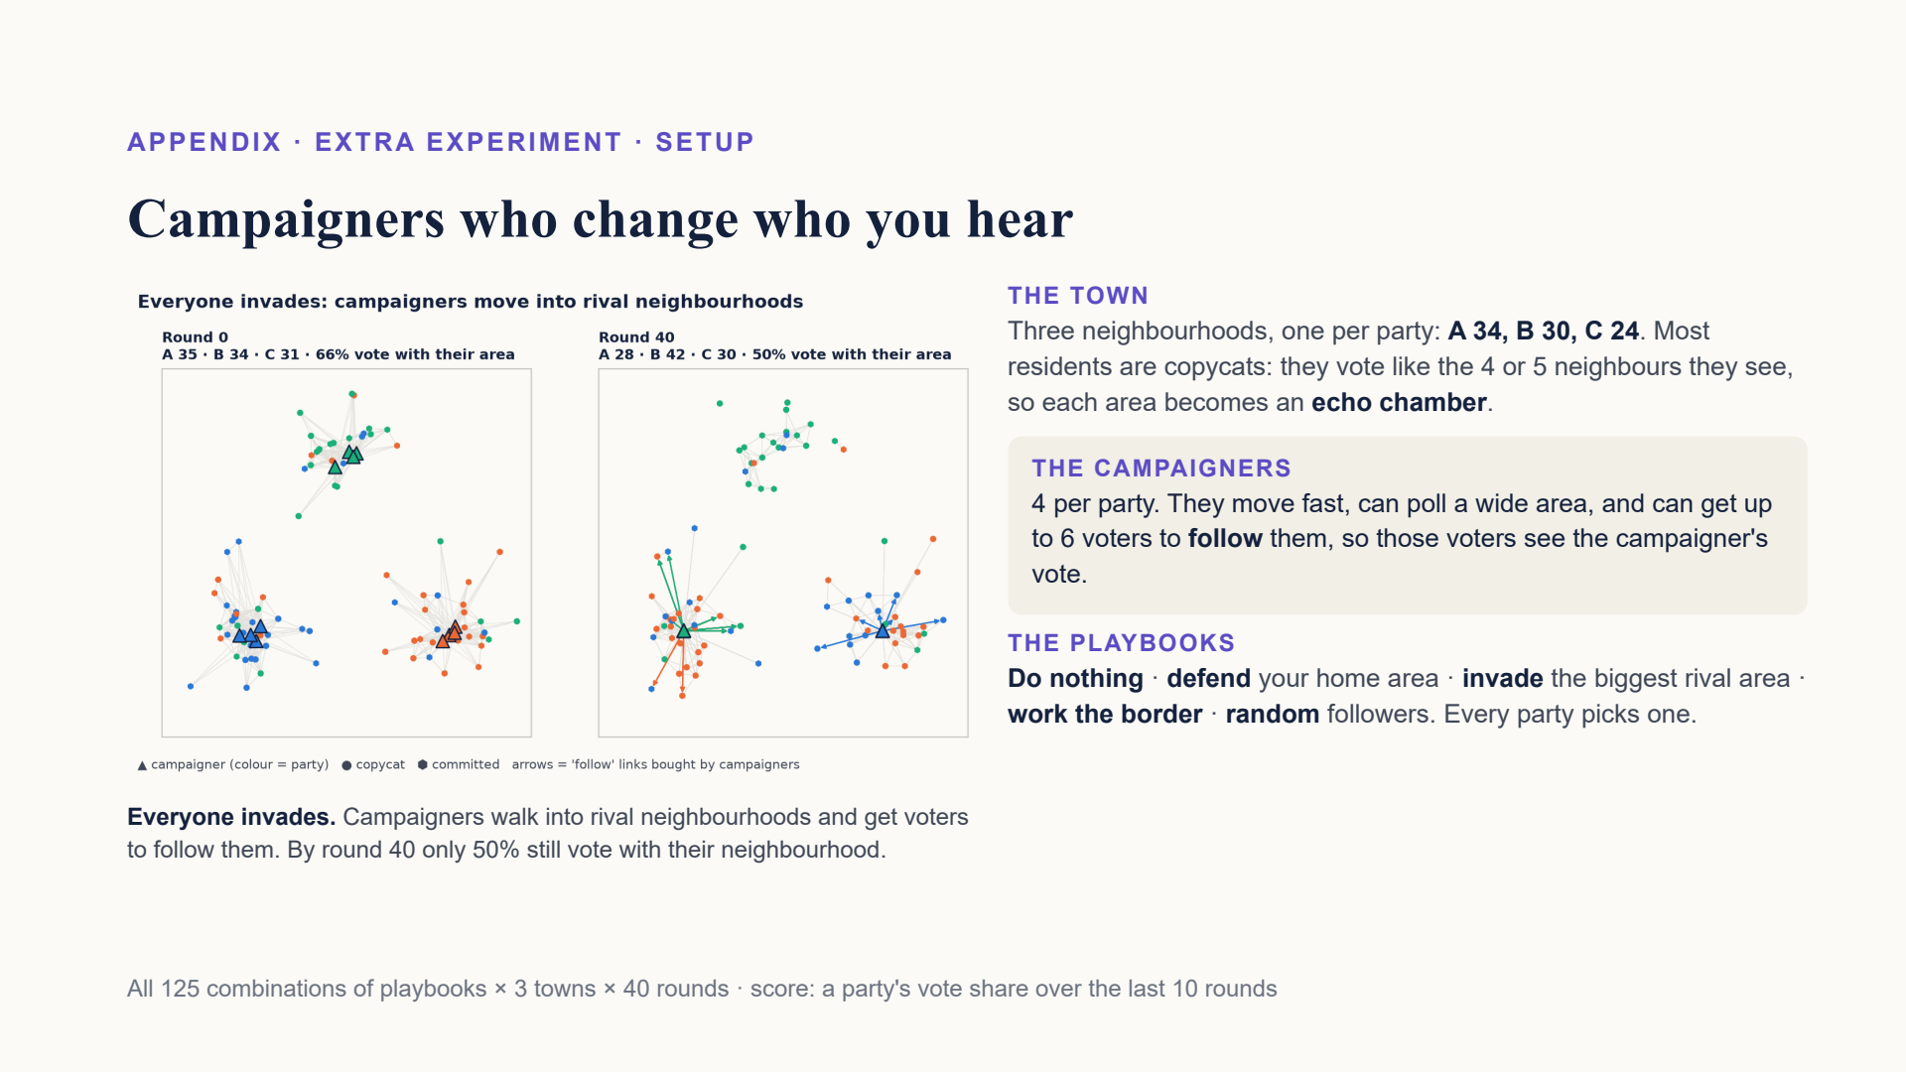
Notes:
Three neighbourhoods, one per party. Most residents copy the most common vote among the 4 or 5 neighbours they can see, so each area becomes an echo chamber. Each party has 4 campaigners who move faster, can poll a wide area, and can make up to 6 voters follow them, which puts the campaigner's vote in front of those voters. Each party picks one of five playbooks. We ran all 125 combinations, 3 towns each.

Slide 29
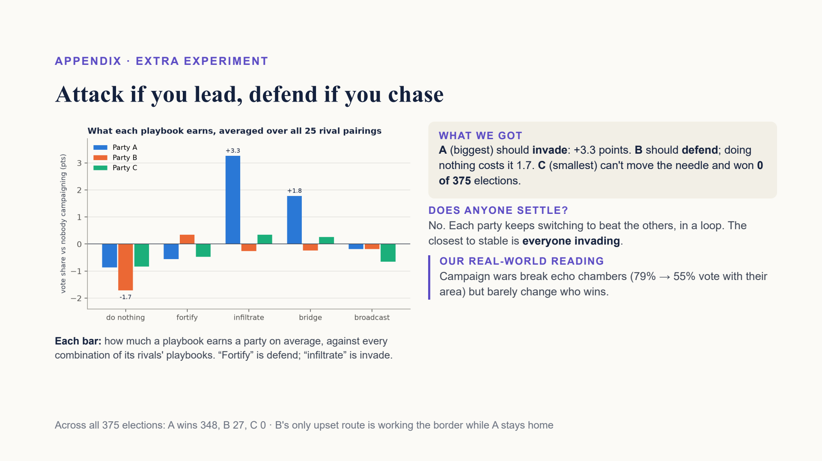
Notes:
Party A, the biggest, should invade: it is the best reply in 19 of 25 match-ups and gains 3.3 points on average. Party B should defend its home; doing nothing costs it 1.7 points. Party C, the smallest, can barely move: at best 0.3 points, and it never won any of the 375 elections. There is no combination where everyone is happy: best replies go round in a loop. The closest to stable is everyone invading. That breaks the echo chambers, from 79% to 55% voting with their own area, but the winner barely changes.

Slide 30
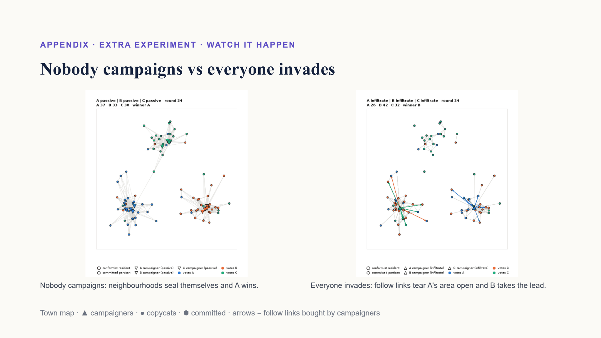
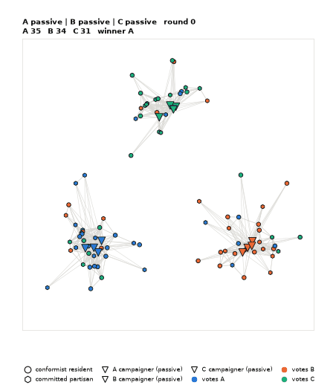
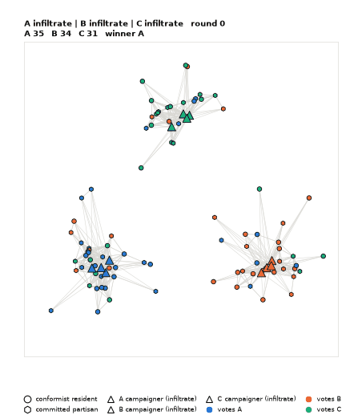
Notes:
Left: nobody campaigns. Each area turns almost entirely one colour. Right: everyone invades. Campaigners walk into rival areas and the arrows are their follow links. A's area is invaded from both sides and splinters, and B takes the lead in this town. Across 3 towns, B won 1.

